Slide 1



SOUTH AFRICAN EDUCATOR’S EXPERIENCES OF MASSIVE OPEN ONLINE COURSES
Presented by: Ncediwe Mdlulwa
Equitable Education and Economies

Slide 2



BACKGROUND
Inclusive education programs fail to empower teachers
Lack of specialized teacher education programs
More than 50% of children with disabilities are out of school.
Most teachers are faced with large classes

Slide 3

INTRODUCTION
Need for additional opportunities for educators outside formal professional development programs
Online learning through Massive Open Online Courses (MOOCs)
Viewed as one way of addressing these issues
Prepare teachers to provide inclusive teaching practices
To create awareness of disability, diversity, and inclusion

Slide 4
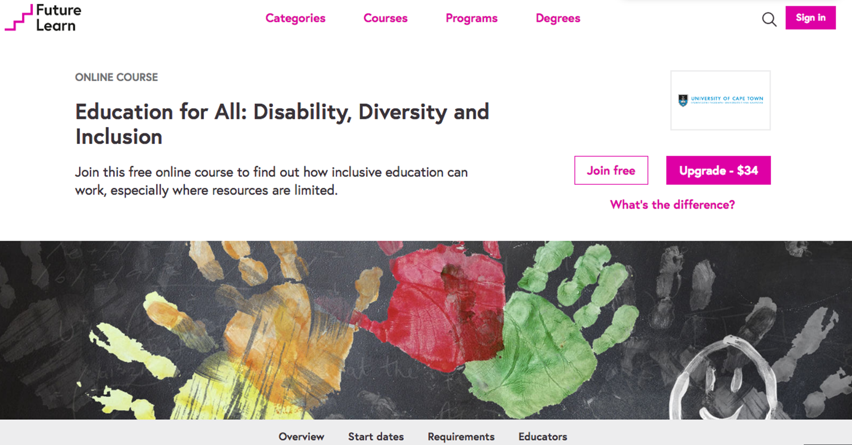
Massive Open Online Course

Slide 5

METHODOLOGY
Qualitative Study
Semi-structured interviews
6 South African teachers who completed the MOOC
Thematic analysis
MOOC as a teacher empowerment strategy conceptually frames this study.

Slide 6
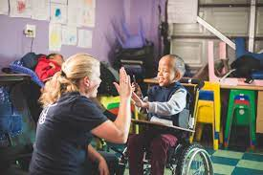
ENHANCED PROFESSIONAL SKILLS
Empowered to teach inclusively.
Built their lifelong learning for continuous professional development (CPD)
Pursuit of further Studies

Slide 7

CHANGES IN PROFESSIONAL IDEOLOGIES
Positive attitudes towards inclusion
Learnt new ways of thinking about inclusion.
Agents of change in their communities

Slide 8


BUILDING SYSTEMS OF SUPPORT
The thing is to be willing to partner with the community, partner with the parents and the learners (circles of care). Then you get an understanding and support when you understand the child and the child’s needs
~ By Graca

Slide 9
BUILDING SYSTEMS OF SUPPORT
…I feel like many teachers should be encouraged to complete this course. Not only teachers…including people that have a role in the making decision like policymakers…so that they can see the importance of inclusive education
~ By Mamokgethi

Slide 10

DISCUSSION
MOOCs inspired teachers to adopt empowerment practices
Exposed to new possibilities such as pursuing additional learning opportunities.
To improve their teaching practices.
To address their day-to-day difficulties in school.

Slide 11

SUMMARY AND CONCLUSION
MOOCs promote empowerment practices and a demand
Teachers to learn about inclusion
To improve their professional ideologies
Exercise their rights to pursue continuous professional development

Slide 12
SUMMARY AND CONCLUSION
THANK YOU ☺
Audience Questions & Answers

