Slide 1



Smallholder Agricultural Production
and Food Security
Dr. Nomcebo Ubisi
Africa Institute of South Africa

Slide 2

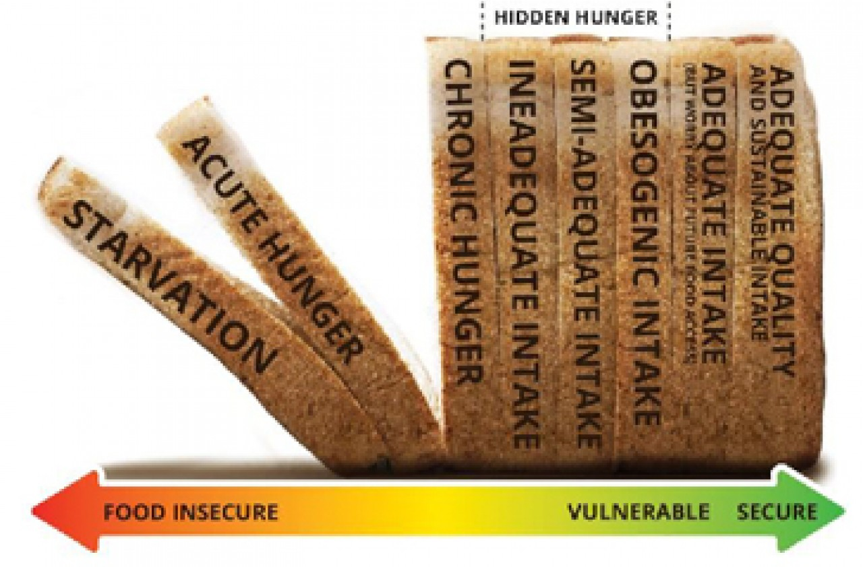

Food Security Challenges
2.1 million (11%) South Africans are exposed to hunger
Global Price Shocks
Unemployment
Poverty
Covid-19 Pandemic
Underdeveloped agricultural sector
Notes:
Smallholder farmers play a key role in contributing to the food and nutrition security status in rural communities

Slide 3
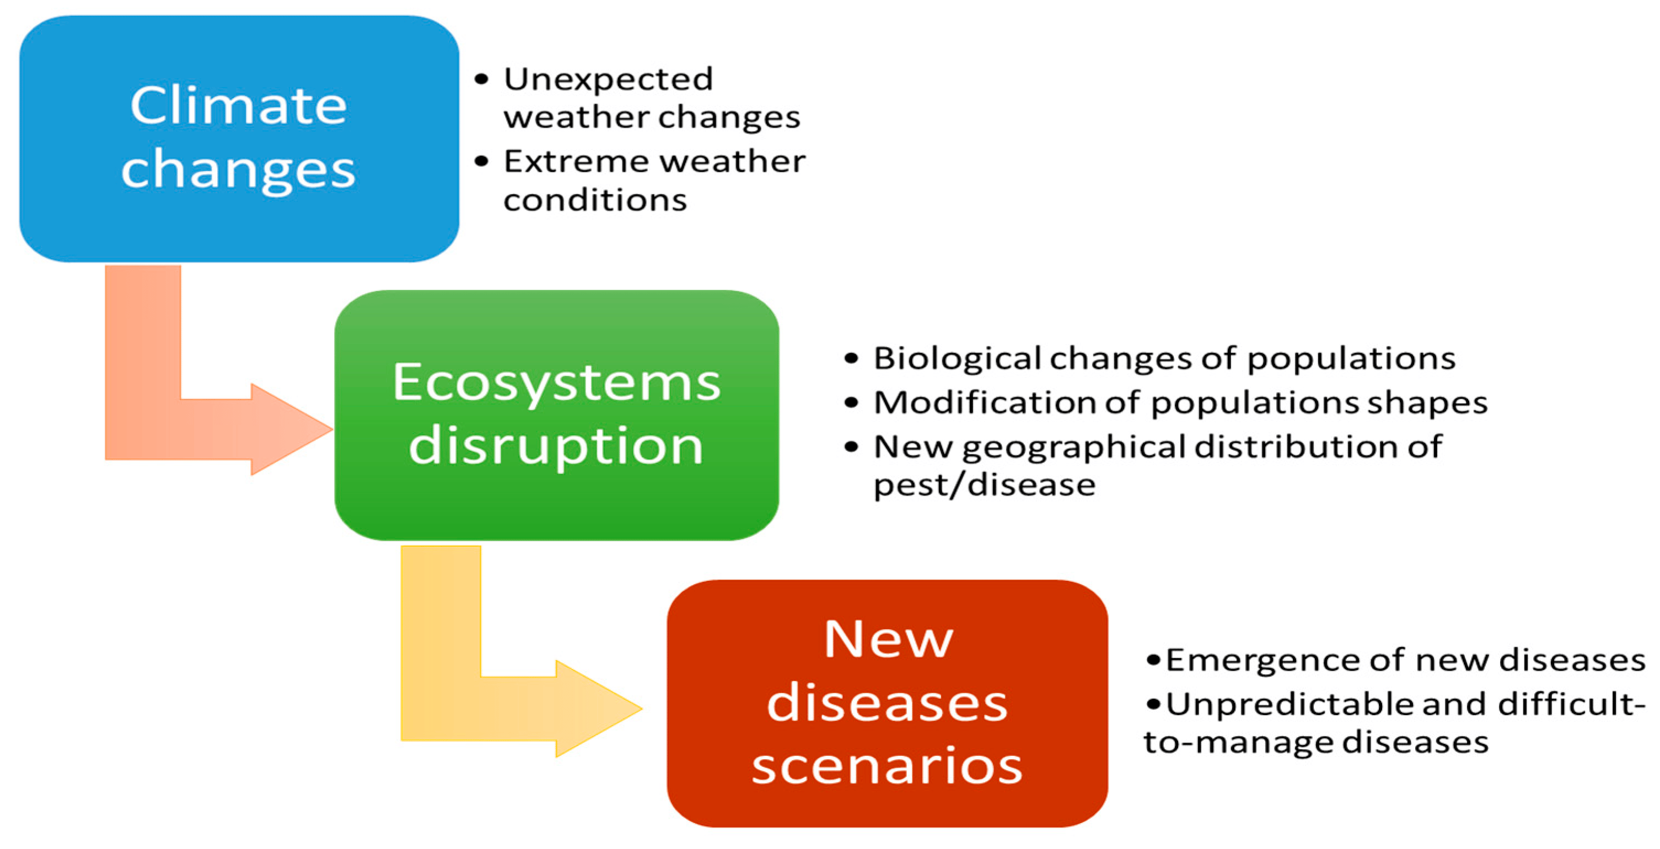

Climate Change Scenarios
Notes:
Drought
Floods
Crop loss
Emerging diseases
Increased temperatures
Livelihood loss
Loss of income
Effects on food and nutrition security

Slide 4
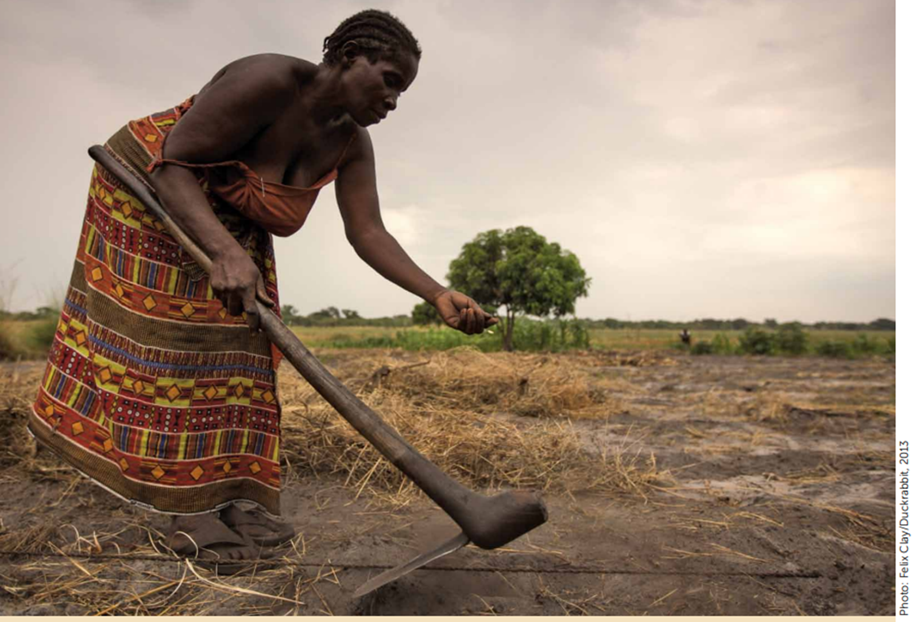

Smallholder Agriculture as a Solution
Notes:
In Southern Africa, agriculture is essential for promoting economic development, eradicating poverty, and enhancing food security.
More than 70 percent of the rural population depends on agriculture for their livelihoods
Smallholder farmers enhance the local food system and the primary food producers in Southern Africa
Approximately 2 million smallholder farmers (compared to 35,000 commercial farmers).
Smallholder farmers are the most vulnerable

Slide 5
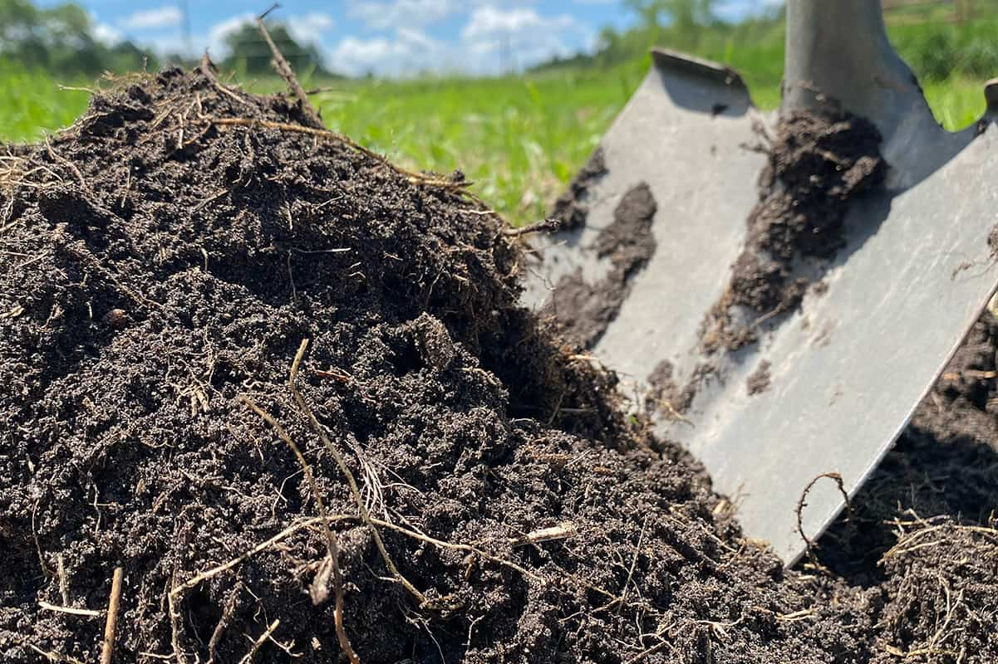

Action Plan: Farmers Input
Fertilizers
Hybrid Seed
Drought-tolerant maize produces 20-30% HIGHER YIELDS in dry conditions
Notes:
fertilizers and seeds

Slide 6
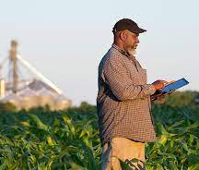
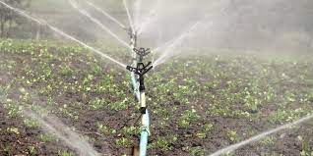
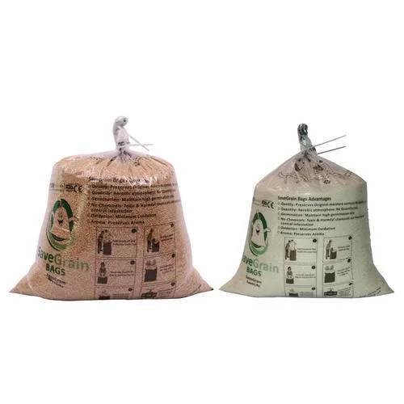
Action Plan: Infrastructure
Irrigation
Innovative irrigation systems
Storage
Post-harvest storage and handling (Hermetic bags)
Technology
Mobile App
Notes:
Drought
Floods
Crop loss
Emerging diseases
Increased temperatures
Livelihood loss
Loss of income
Effects on food and nutrition security
Government budget cuts in vital support functions such as extension services and research and development
Post-harvest: hermetic bags to reduce post-harvest losses procuring produce from smallholder

Slide 7
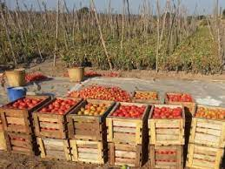
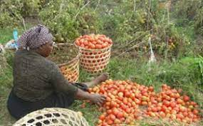
Action Plan: Markets
Trade
Improve regional trade flow
Certification
Sorting of produce and Pricing
Notes:
Market access: online farmers markets or creating linkages with private sector/African countries
Market access through innovative means such as online farmers markets or creating linkages with private sector and schools creating assets (such as roads, market
Farmer cooperatives: collectively address challenges, pool resources, share knowledge, and access markets. These collaborations can enhance their bargaining power, increase access to finance and resources, and promote knowledge exchange among farmers.

Slide 8
Recommendations
INVEST in rural Smallholder farmers
Disseminate climate and crop INFORMATION
Build farmers' CAPACITY IN INNOVATIVE practices
Train farmers in POST-HARVEST HANDLING (low-cost storage solutions)
Provide TECHNICAL assistance (Capacity building)
Invest in FINANCING smallholder farmers
Integrate IKS and modern science
INVOLVE smallholder farmers
Promote cross border trade (AfCFTA) – AFRICA FOCUS
PURSUE RESEARCH WITH IMPACT
Notes:
Government budget cuts in vital support functions such as extension services and research and development

Slide 9
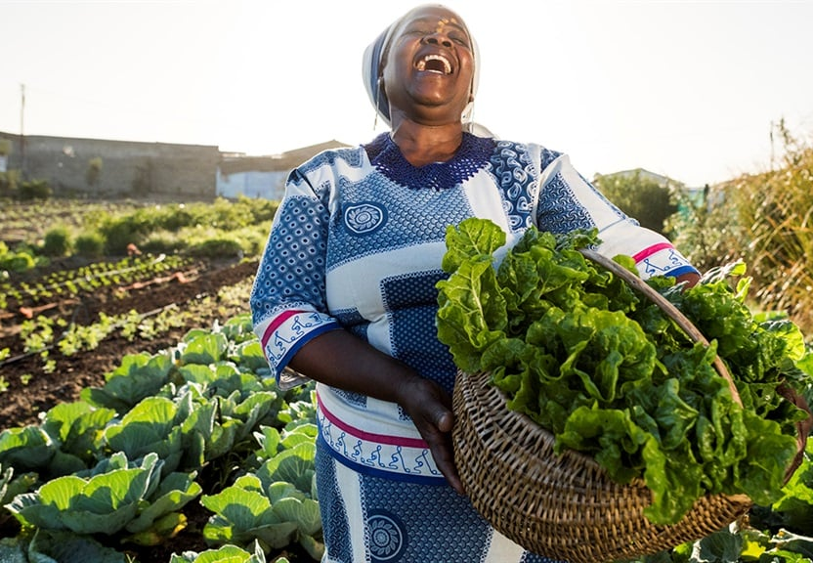
Equip a Smallholder Farmer - Feed the Nation!

