Slide 1



Twitter Data Mining and Sentiment Analysis of Cholera Outbreak: Hammanskraal Case Study
Presented by: Emmanuel Fundisi
Geospatial Unit/eResearch Knowledge Centre

Slide 2

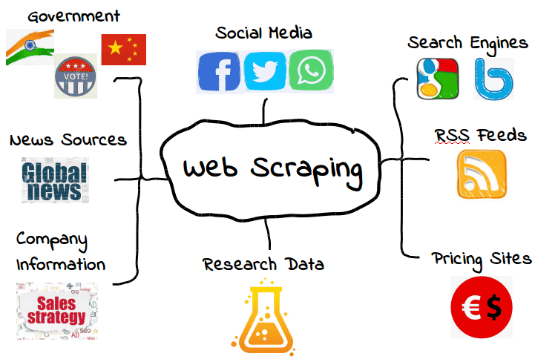


Introduction
Big data mining/analysis of social media platforms has had a profound impact in human science research.
Information is extracted in real-time affording invaluable insights into social dynamics and public opinion.
Web-scrapping.

Slide 3
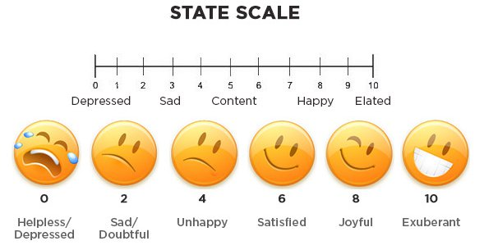


Cont.
eg: Subjective Well-Being
Definition
Traditional Approach
Opportunity
Subjective Well-being (SWB) = Reflective cognitive judgments + Emotional feelings. Provides a measure of life satisfaction
Traditionally SWB has been measured using surveys, however they have scalability issues, significant time delay and high cost
Social media users generate useful traces of their attitudes, beliefs, and feelings at every moment

Slide 4
Cont..
Due to its sheer volume, machine learning algorithms have to be used to analyse the data.
By analyzing social media data, researchers can:
    identify patterns of behavior,
    predict future trends,
    forecast outcomes in socio-economic issues, public health, politics, etc.

Slide 5
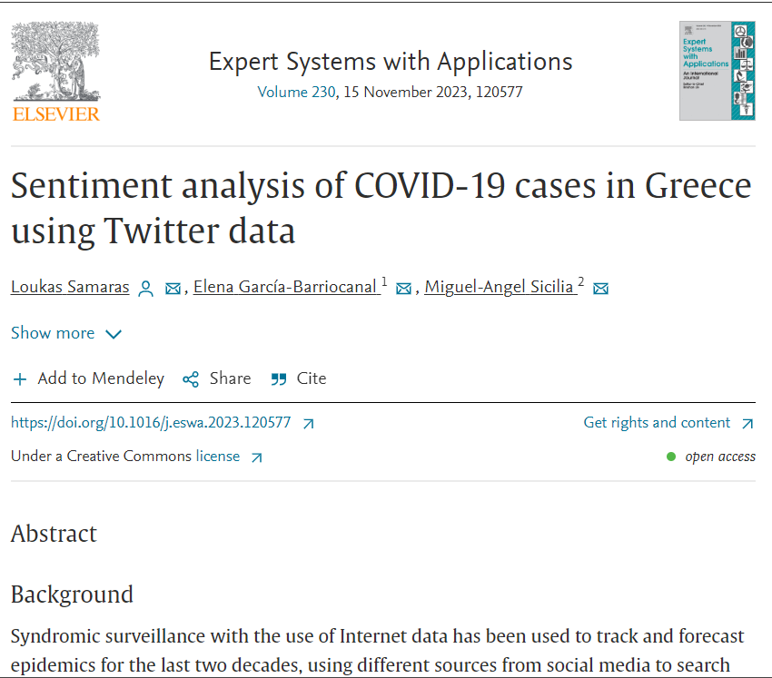
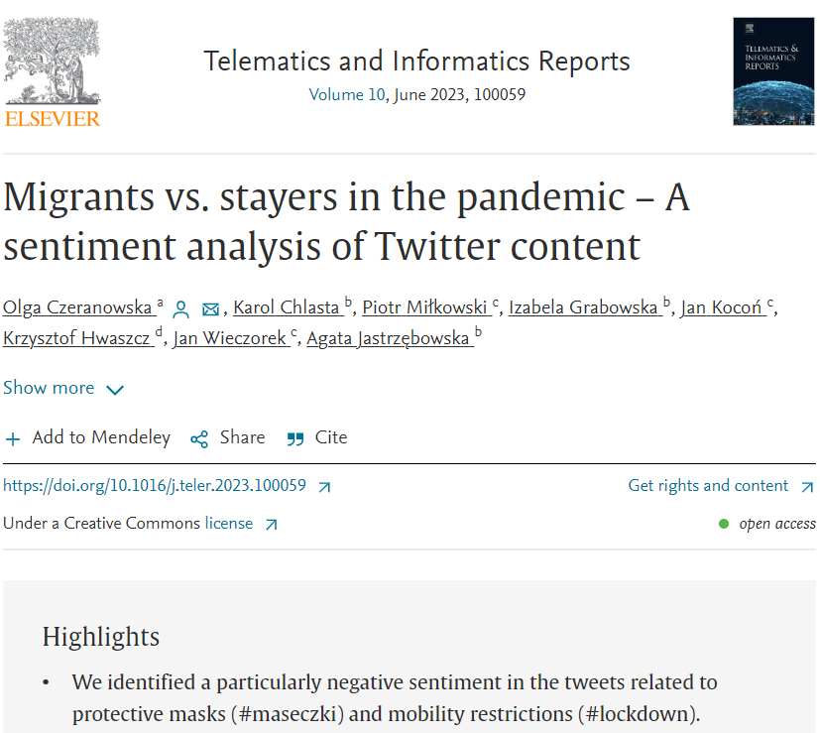
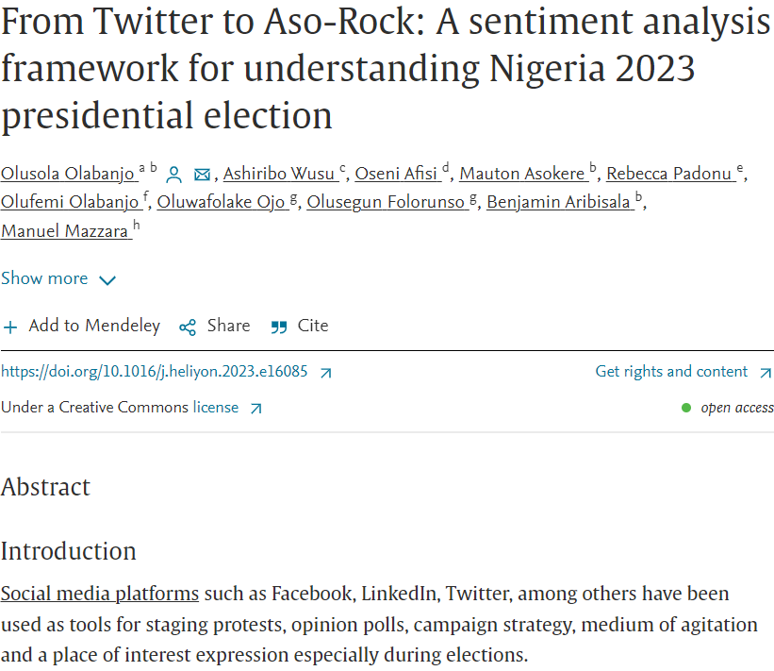
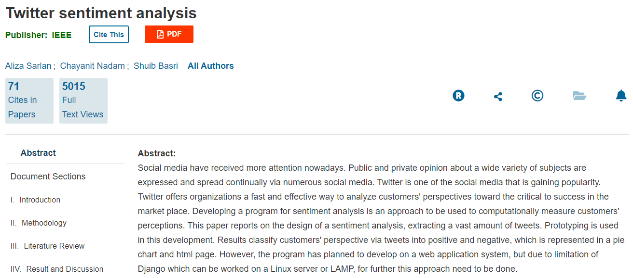
Literature review

Slide 6
Cont.
Social Media sentiment analysis
    Hotel reviews to get a better understanding of customer’s likes and dislikes.
    Health care - customer opinion, customer satisfaction.
    Business - reputation management, market research, competitor analysis, product analysis, etc.

Slide 7
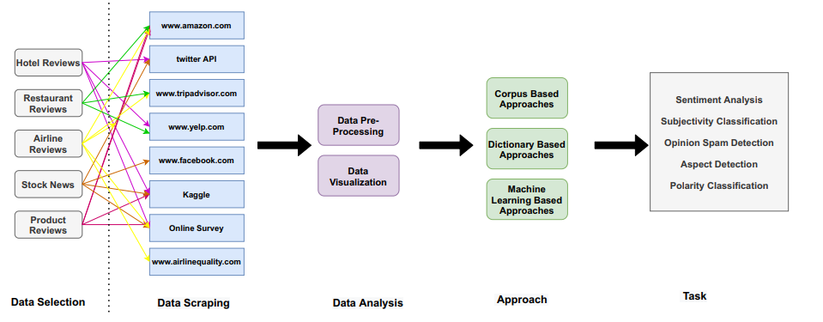
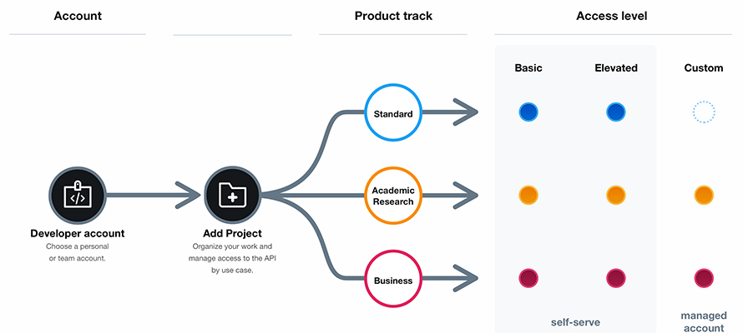
Cont..

Slide 8
Aim
Explore the use of Twitter data mining and sentiment analysis, on public sentiment around the cholera outbreak recorded between May and June 2023 in Hammanskraal, South Africa.

Slide 9
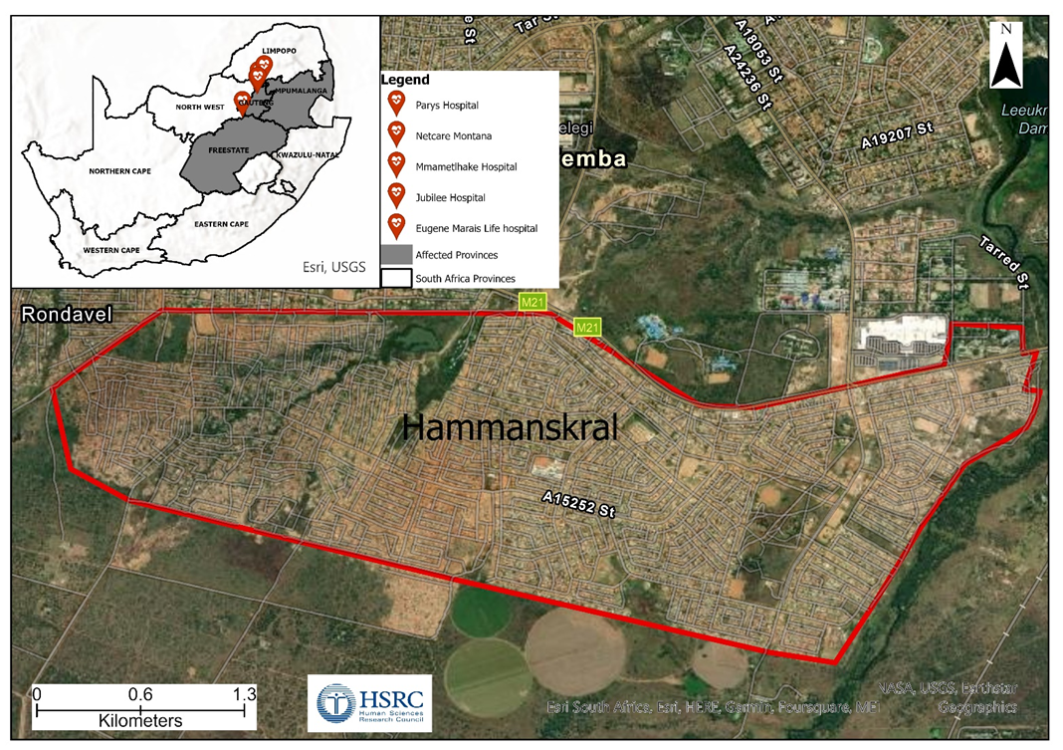
Methodology
Cholera statistics
(05 June 2023)
Death toll: 26
Hammanskral hotspot (24)
Mpumalanga (1)
Free State (1)
Over 130 positive cases
Web scraped data.
Source: National Health Department

Slide 10
Cont.
Sentiment analysis and Natural Language Processing, deals with informal writing style, sarcasm, irony, etc.
There are many words in different languages whose meaning and orientation change depending on the context and domain in which they are employed.
Sarcasm and irony are two most critical challenges in Natural Language Process and Sentiment Analysis.

Slide 11
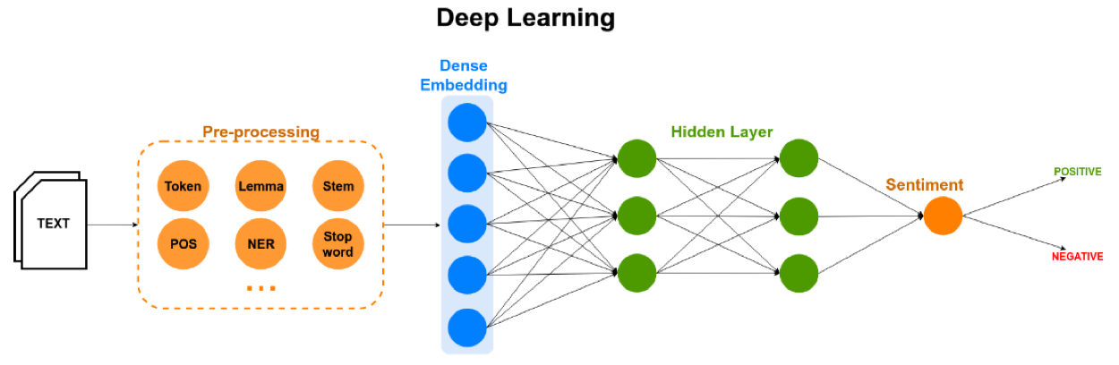
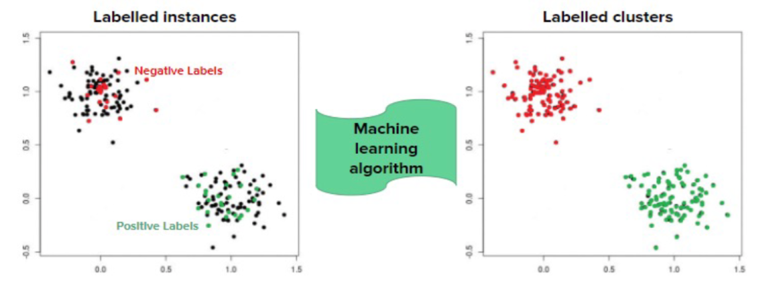
Cont..

Slide 12
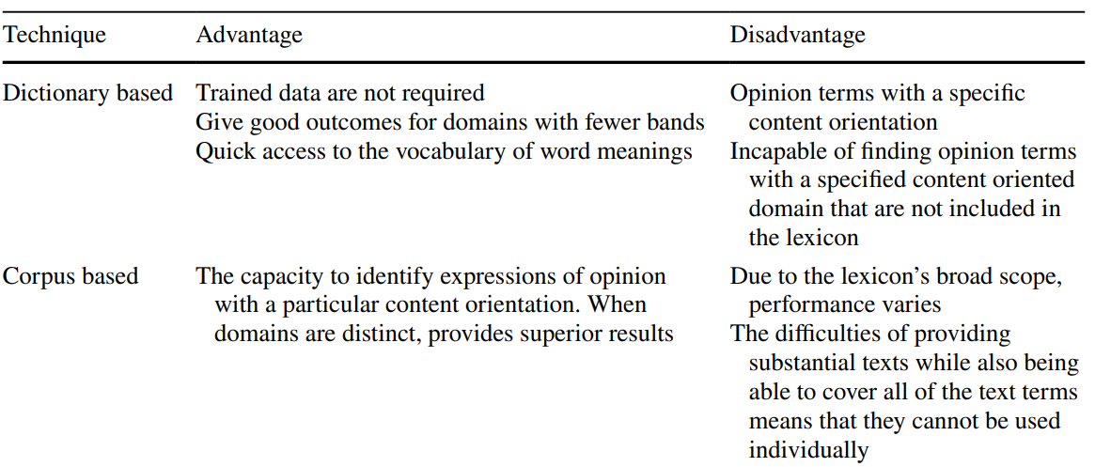
Cont…

Slide 13
Cont…
The TV screen is too small and “This camera is extremely small, the word “small” in the first sentence is negative, as people generally prefer large screens, whereas in the second
sentence it is positive, as if the camera is small, it will be easy to carry.

Slide 14
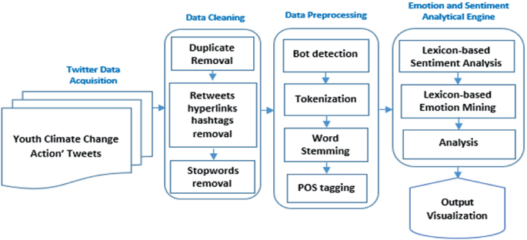
Cont…
RT @Katlego_Mack: The Hammanskraal cholera outbreak is infuriating because the water issue has been there for such a long time now.
RT @ewnreporter: Community members of Hammanskraal chase away Tshwane Executive Mayor, Cilliers Brink at the Jubilee Hospital.
RT @SABCNews: The Gauteng Health Department has confirmed that the death toll in the cholera outbreak in Hammanskraal has now risen to 13.
#Hammanskraaldisaster: Hammanskraal and infected Water come a long way. We should not be surprised â€¦ https://t.co/W1K7Fs1bYJ
Tweets

Slide 15
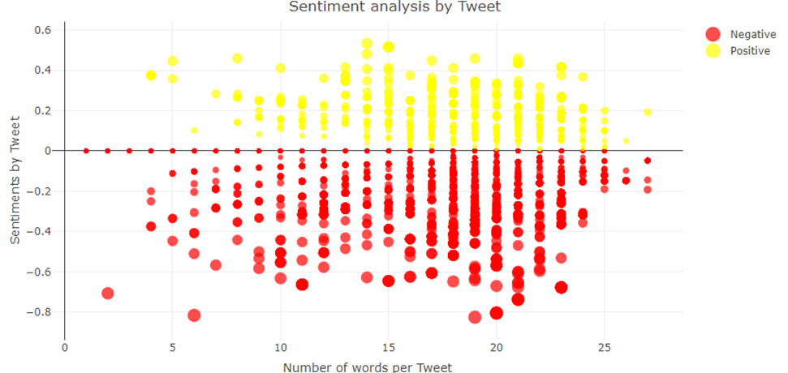
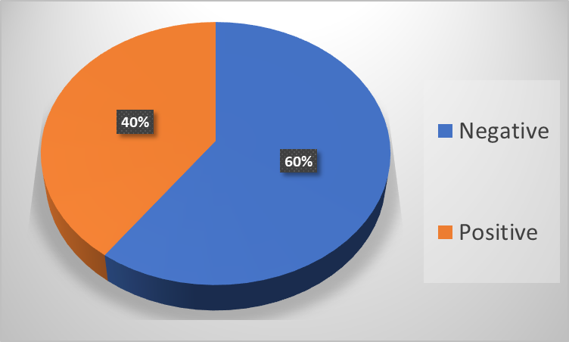

Findings

Slide 16
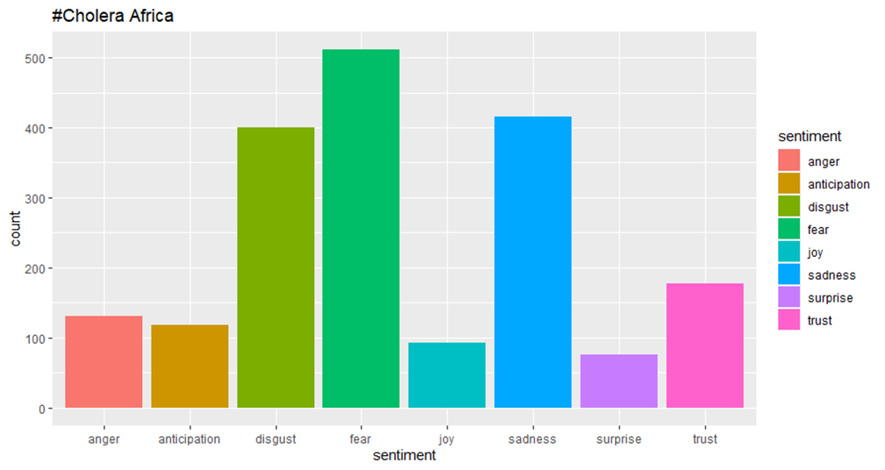
Cont.

Slide 17
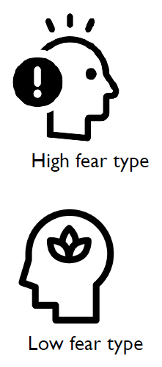
Cont.
Fear and Behaviour
Higher fear group less likely to trust and follow government response, directive.
Hence might lead to more sporadic spread of the outbreak.

Slide 18
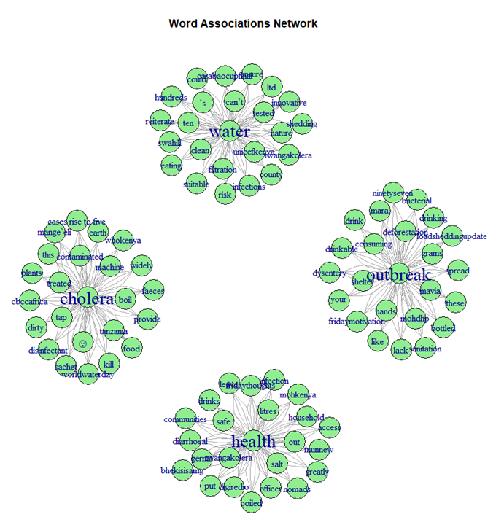
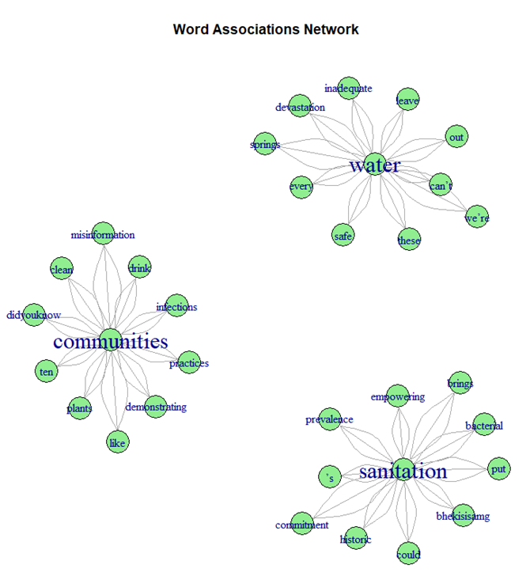
Cont..

Slide 19
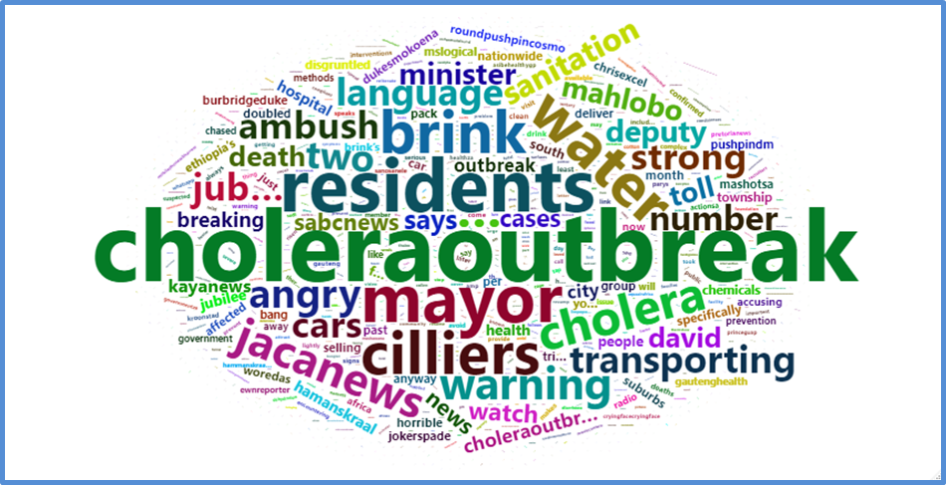
Cont..

Slide 20
Discussion
Negative public perception of government or health authorities' response to the outbreak, policymakers may need to reassess their communication strategies and increase transparency.
Public sentiment can affect people's willingness to cooperate with intervention measures. If negative, it may be necessary to improve community engagement and education.

Slide 21
Discussion
Highlight specific areas of concern or confusion in the public.
Researchers can use this information to prioritize research topics. If public sentiment suggests a lack of understanding about transmission routes, research efforts can focus on clarifying this aspect.
Resource allocation for medical supplies, personnel, can be informed by the sentiment analysis, ensuring that areas with the most negative sentiment receive the necessary support.

Slide 22
Summary
Sentiment analysis of public discourse surrounding a cholera outbreak can yield valuable insights that have implications for policy, further research, and intervention strategies.
Real time content that enables more targeted and adaptive approach to managing outbreaks and mitigating their impact on affected communities.

Slide 23
Summary
Take away
Existing network approaches: Gravity model (Anderson,2011): assume spillover effect decays with geographical distance.
Online network goes beyond geographic constraints.
Can we use data-driven approach to develop a dynamic information network?

Slide 24
Thank You

