Slide 1


The ‘Academic Precariat’: Towards professionalizing postdoctoral fellowships in South African higher education institutions
Zama M Mthombeni
Human Sciences Research Council
University of KwaZulu Natal

Slide 2
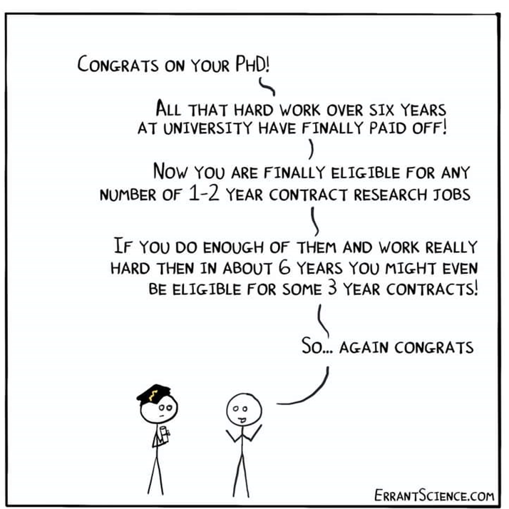
Postdoc Loop’ - Where the cycle of hard work continues!"

Slide 3

"Postdoctoral Opportunities in South Africa: A Pathway to Success or an Opportunity Trap?"
Postdoctoral fellowships started in the lates 1990s in South Africa
The fellowships usually range from 12 months to up to three years and fellows.
It is estimated that in 2020 there were 2 867 Postdocs(CHE, 2022)
Although postdocs do core academic work and possess PhD’s these fellowships are not jobs (Kerr 2022).
These fellows do not get benefits as full time university employees.
“Professional development" is frequently employed to rationalize the role of postdoctoral fellowships

Slide 4
"Research Focus: Exploring Postdoctoral Fellowships in South African Academia"
Research Problem:
Postdoctoral fellows in South African academia face employment insecurity despite their essential roles and qualifications, raising concerns about job security and career progression.
Research Question:
How does the limited employment structure of South African postdoctoral fellowships impact fellows' professional growth, job security, and well-being?
Aim:
This study examines the impact of temporary postdoctoral fellowships on career prospects and overall well-being, of fellows

Slide 5
Conceptual Framework: Academic
Precarity
Academic Precarity
Opportunity Trap: Encountering limited career growth
De-professionalization: Undervaluation of postdocs
Precarious Employment: Temporary nature of employment
Postdoctoral Identity: Formation & negotiation of scholarly identity
Human Capital:
Investment in human knowledge as a means of enhancing individual productivity and economic growth

Slide 6

Methodology
Two qualitative approaches:
Critical Discourse Analysis:
Analysis of universities' online representations of postdocs (Univ Websites).
Postdoc recruitment, program descriptions, and faculty profiles, were examined.
Textual Analysis
Social Media Interactions:
With current and former postdocs (N=35).
Thematic Analysis

Slide 7

Results & Discussion
Institutions Portray Postdocs mostly benefitting them
Postdoc Fellowships justified as career development initiatives
Fragile Identity of Postdoc Researchers
Post Docs feel more as Students than Working Professionals

Slide 8

Exploring Institutional Portrayals
Postdocs are there to strengthen research capacity (UJ, UKZN, UFS).
Postdocs is to assist in increasing research outputs and technology innovation (CPUT)
Postdoctoral Fellowship is to assist with the professional development (WITs, UNIZULU, UP, SU, UFS & NWU).
Postdocs are intended to directly benefit the university (UCT & UNIZULU)

Slide 9
Postdoctoral Fellowships as Catalysts for Career and Academic Development"
Recurring theme observed across most webpages revolves :
Be advantageous or contributory to the fellows (skills etc),
By offering avenues for career growth, professional enhancement, knowledge acquisition, research exposure, and mentorship,
Can serve as a preparatory phase for an eventual academic vocation or future employment.

Slide 10

Fragile Identity of Postdoctoral Researchers
Prevalent theme was the distinction drawn between postdocs and employees due to their tax-exempt status.
As these scholars reflect on their roles and contributions, the lack of official employment status becomes a salient feature that shapes their experience.

Slide 11

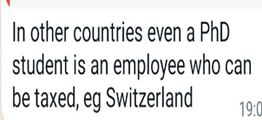
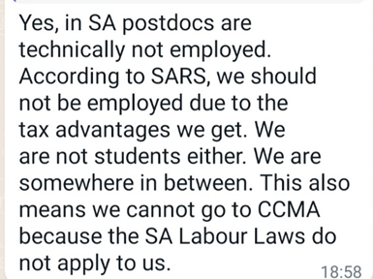
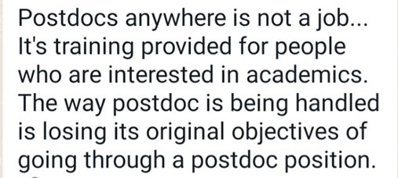
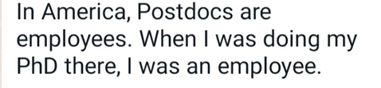
Conversations on a social media platform with postdocs

Slide 12

Undervalued Scholarship and Integration of Postdocs into the Academic Community
Unofficially employing high-level experts minimizes financial impact while maximizing output utilization
Publications elevate postdocs' academic profiles, yet economic benefits tend to favor institutions disproportionately.
South African higher education aligns with global trends, embracing a corporatized approach and using financial incentives to drive increased research 'outputs.'"

Slide 13

Human Knowledge and Economic Growth Fallacy
Postdoctoral fellow system does not in fact expand the number of actual permanent academic job vacancies that are available.
Universities hardly have plans of absorbing postdocs into the permanent academic staff after a certain number of years
"Postdoctoral Fellowships: Generating More Postdocs, Not Employment Opportunities"

Slide 14

Develop Research-intensive institutions with a strong human capital base
Strengthening the next generation of academics with progress within the academic pipeline.
What does Academic pipeline look like?
Progressing those at the pipeline (postdocs)
Academic profession should not be broken down into more temporal, short-lived segments, rather than being a continuous, cohesive profession.

Slide 15

Future Directions: Where to from here?
"Are we misleading aspiring academics by promoting careers without sufficient opportunities for their fruition? It's crucial to have an open dialogue about the academic pipeline rather than solely pushing for PhD enrollment, especially when the academic profession's prospects are limited thereafter."

