Slide 1










THE SIXTH SOUTH AFRICAN NATIONAL HIV PREVALENCE, INCIDENCE, AND BEHAVIOUR SURVEY (SABSSM VI)
20 YEARS OF STRATEGIC HIV AND PUBLIC HEALTH DATA
Key findings
Presentation to Working Group
7 November 2023

Slide 2

OVERVIEW OF PRESENTATION
Background about the SABSSM survey series
Main objectives of the study
Study methods
Results
  Response rates
  National HIV prevalence
  Viral load suppression
  Progress towards 95-95-95 targets
  Male circumcision
  Condom use
Concluding remarks

Slide 3
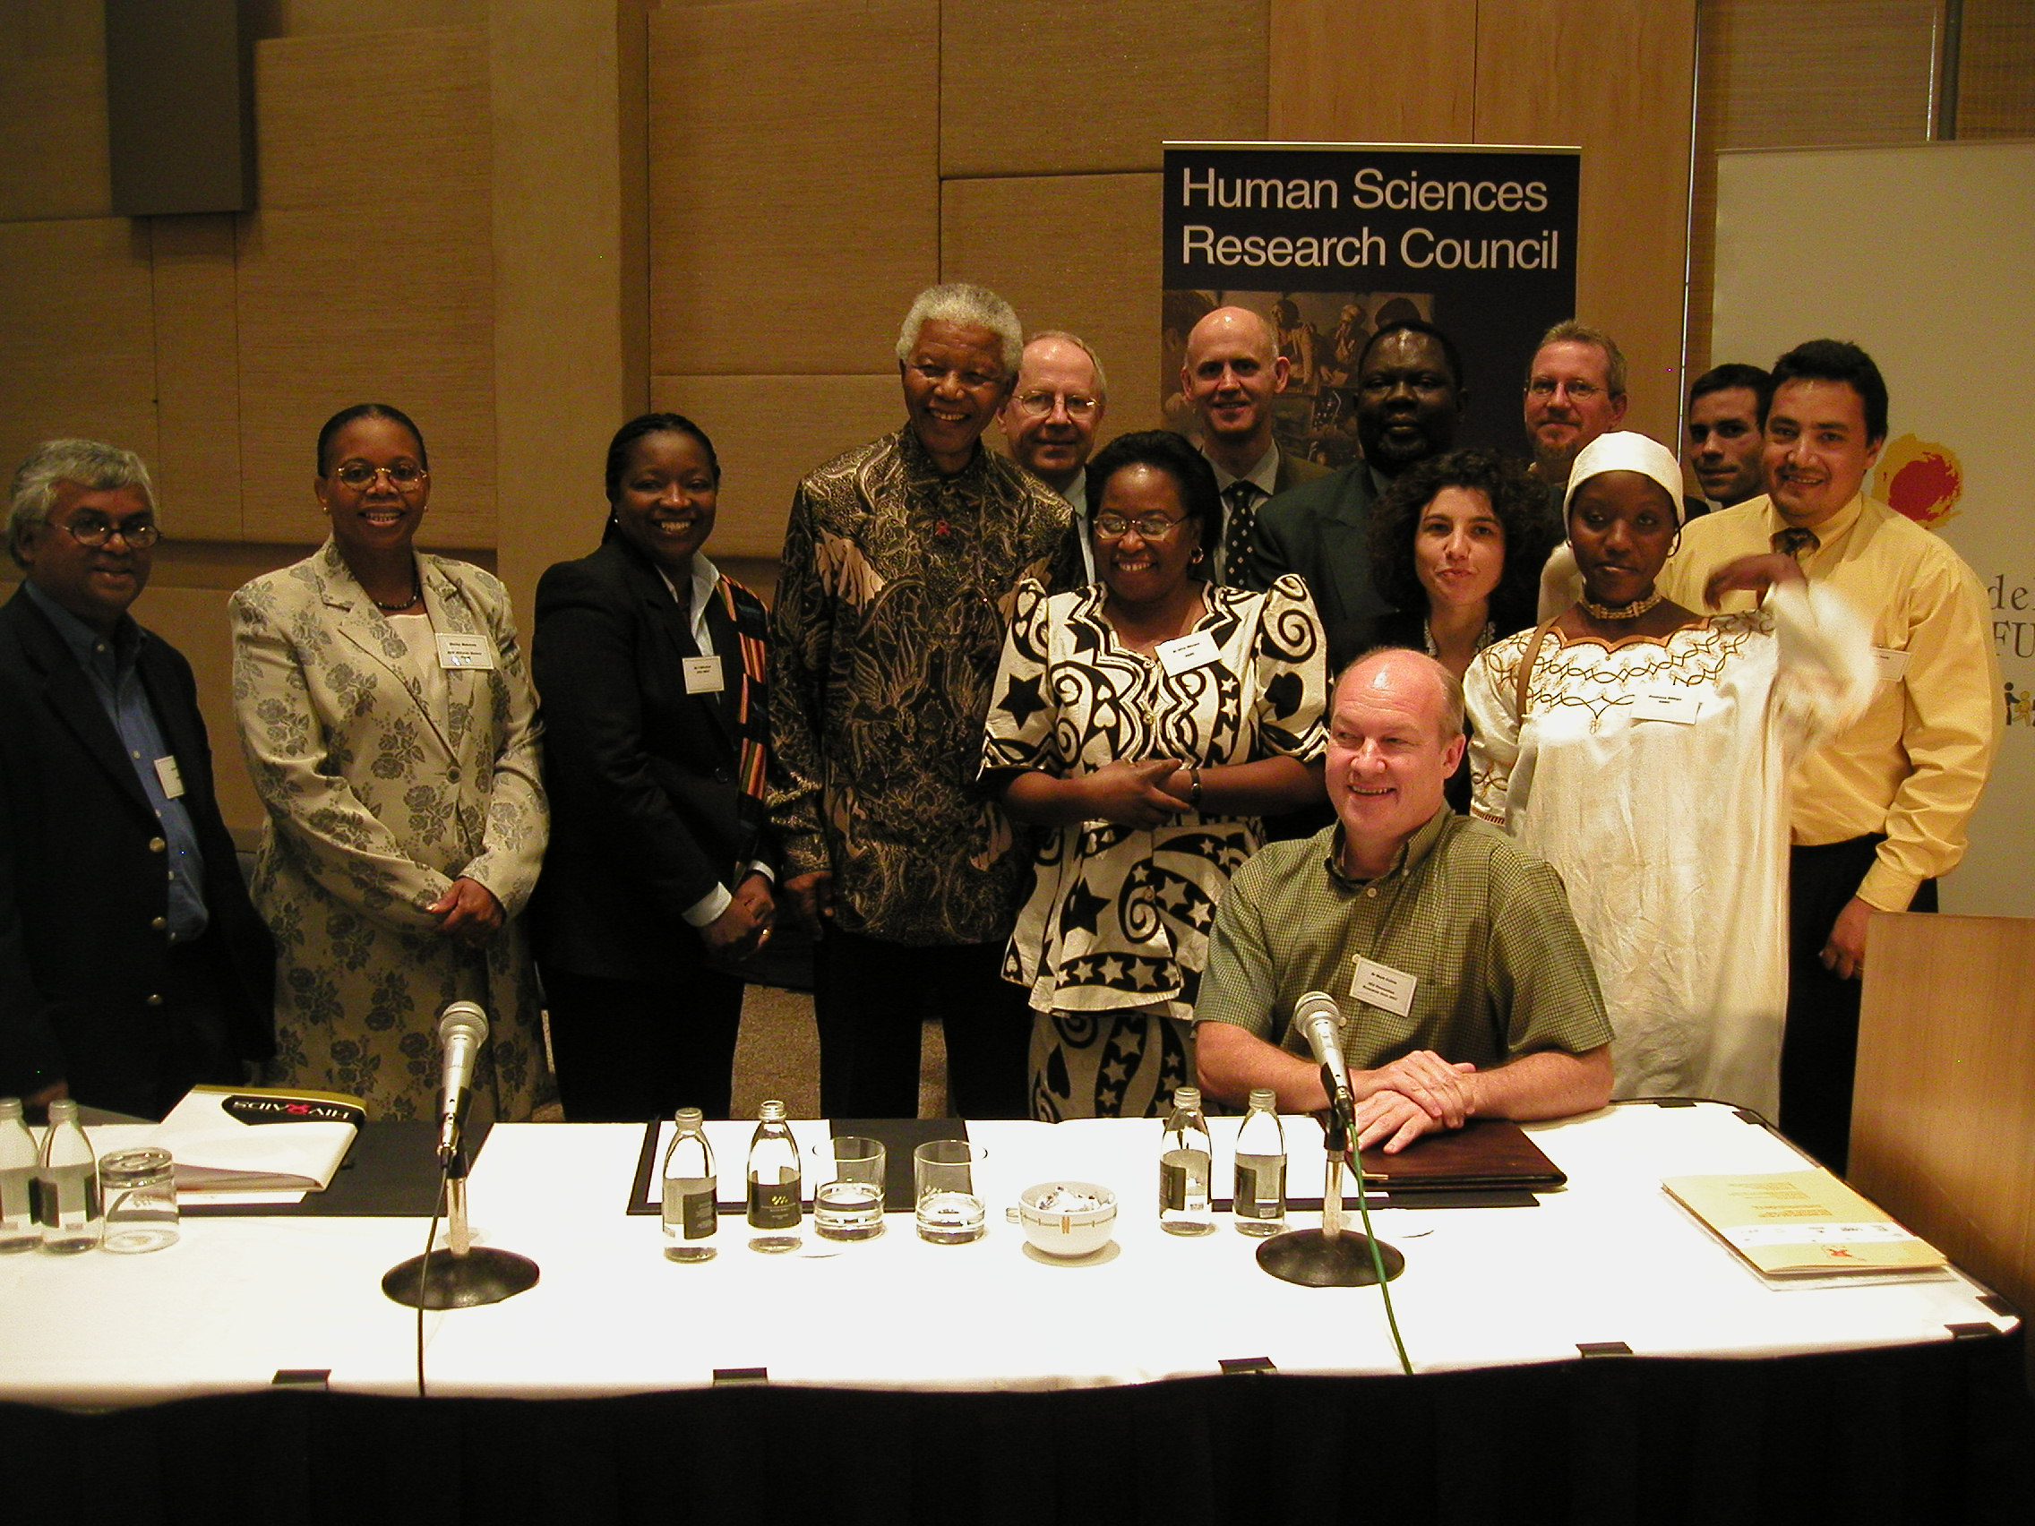
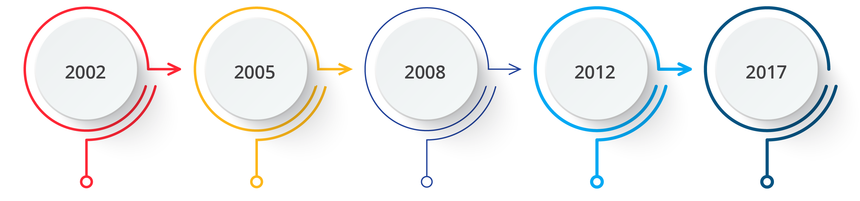
WAY BACK IN 2002
Expanded scope
Larger sample size
Increased biomarkers
Take all approach
Electronic data collection
Survey year
Major source of information for measuring the progress of the implementation of the South African National Strategic Plan (NSP) for HIV, STIs and TB

Slide 4
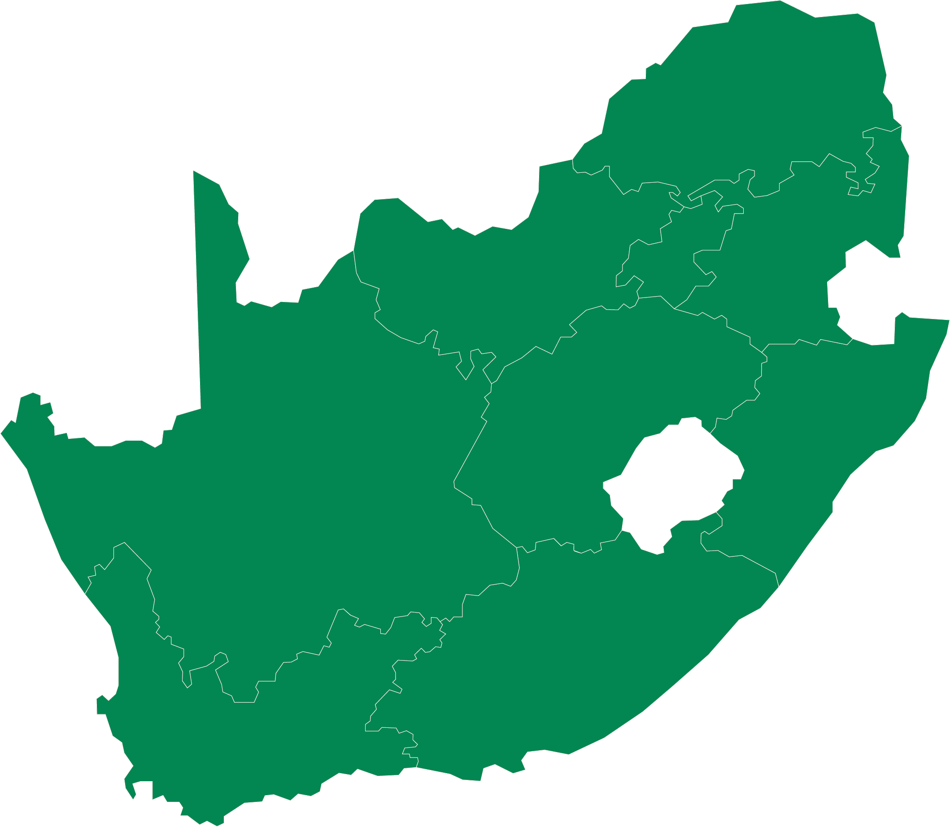
MAIN OBJECTIVES
To estimate at national, provincial and district levels (PEPFAR and NDoH priority):
  HIV prevalence (adults and children)
  Exposure to ART
  Viral load suppression in HIV-infected individuals
To estimate at national level:
  HIV incidence (annualized rate
  of new HIV infections)

Slide 5

STUDY METHODS
Geographic scope
National level: 9 provinces
District level: 27 PEPFAR and 6 National Department of Health priority districts
Study design and population
  A cross-sectional, population-based household survey, using multi-stage stratified cluster random sampling
  The study design and methods are validated in the five previous surveys
Survey population
  Persons of all ages living in South Africa at the time of the survey
  All members of the selected households were invited to participate
  Data collection occurred over 15 months, from January 2022 to April 2023

Slide 6
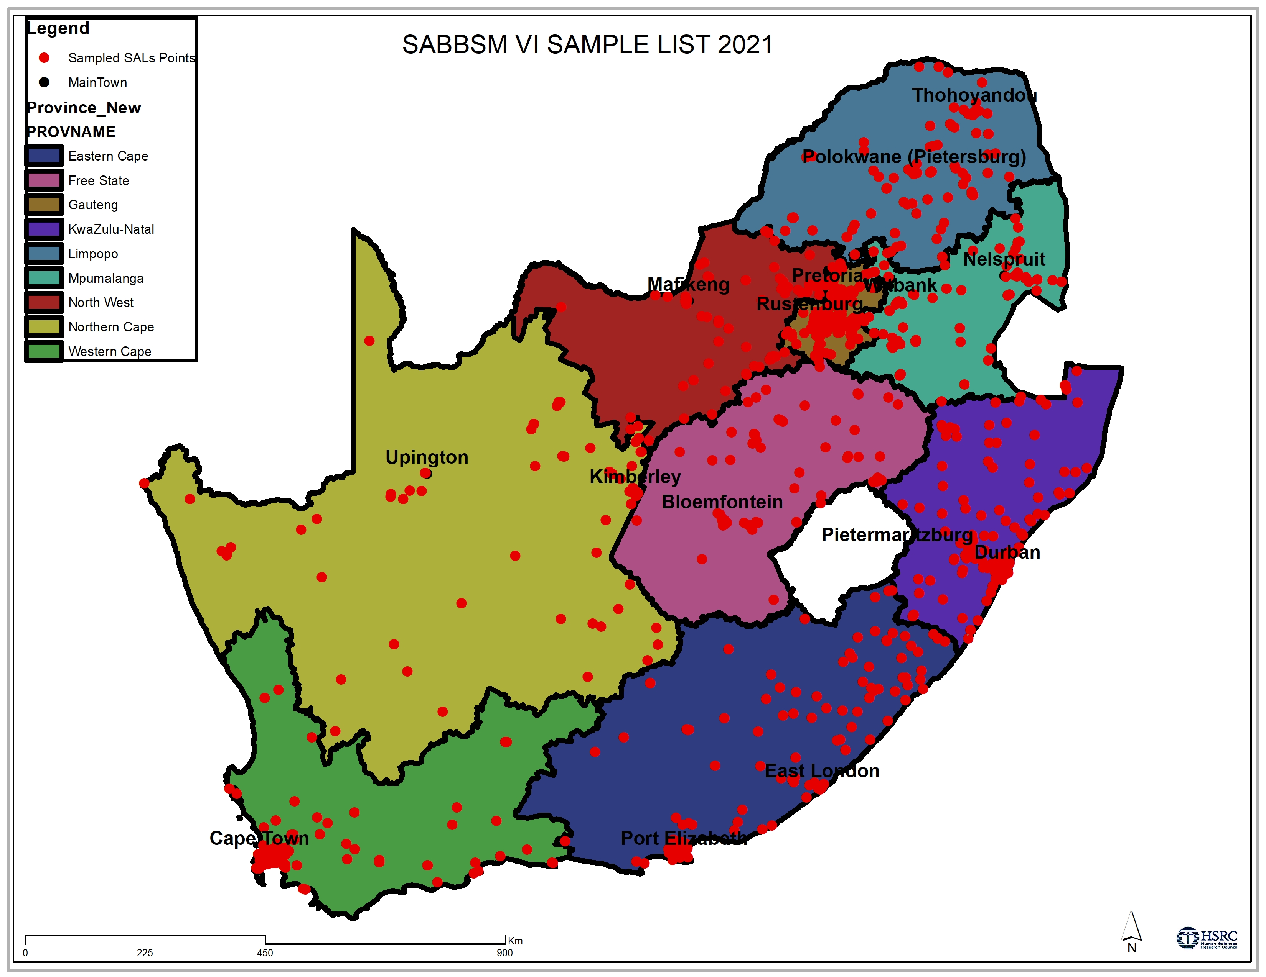
Limpopo
GP
Mpumalanga
North West
Free State
KZN
Northern Cape
Eastern Cape
Western Cape

Slide 7

QUESTIONNAIRES
Household Questionnaire
This questionnaire was used to record a household listing of members and other household-level information
Individual questionnaires
Questionnaire for parent/guardian of children aged 0 to 11 years
Questionnaire for children aged 12 to 14 years
Questionnaire for persons aged 15 years and older

Slide 8
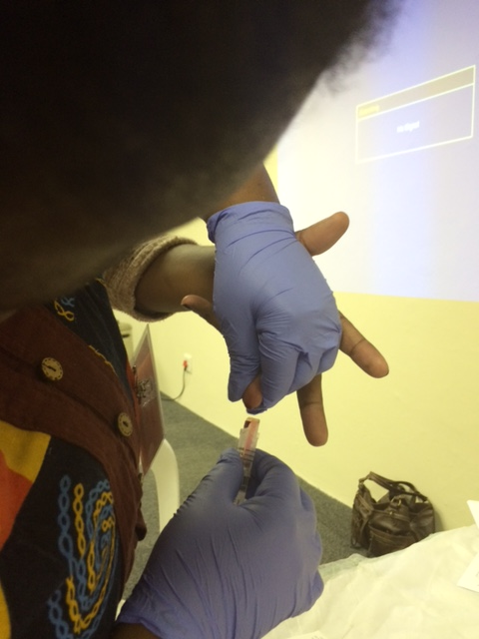
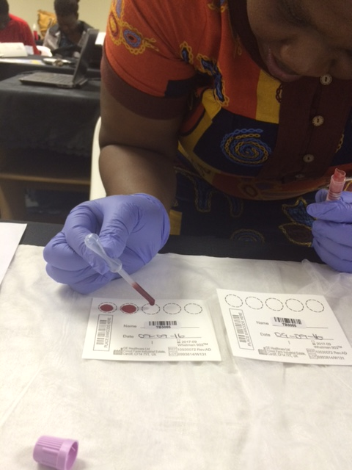
SPECIMEN COLLECTION
Dried blood spot (DBS) specimens
collected by
finger-prick
heel-prick in infants < 24 months

Slide 9
SPECIMEN TESTING
Dried Blood Spot
HIV Ab testing
Two 4th Generation EIA plus
confirmatory testing
Nucleic Acid Amplification
test < 24 months
HIV Pos
*HIV Incidence
(> 2 years)
LAg assay/ RITA plus
ARVs
HPLC coupled with Tandem Mass Spectrometry
Viral Load
HIV-1 RNA on
Abbott m2000 HIV
Real-Time System
*HIV
Drug Resistance
(VL>1000cl/ml)
Next-generation sequencing
* Not reported in this presentation

Slide 10
WEIGHTING PROCEDURE
Small area layer (SAL) (primary sampling unit) weights reflect the allocation of SALs according to the three stratification variables, namely race, province, and locality type.
In each sampled SAL, a systematic random sample of 15 visiting points (VPs) was selected, with VPs in each SAL having the same base weight.
SAL base weights were adjusted to correct for the invalid and unrealised SALs
VP weights were computed as the counted number of VPs in the SAL, corrected proportionally for invalid VPs, and divided by the number of VPs participating in the survey.
Final VP sampling weight was computed as the product of the SAL sampling weight and the VP sampling weight.
Demographic and HIV-testing information for all household members within the responding SALs were gathered to calculate individual sample weights.
These individual weights were further adjusted for questionnaire and HIV-testing non-response.
The final individual weights were benchmarked against the 2022 census population by age, race, sex, and province.

Slide 11
RESULTS

Slide 12
RESPONSE RATES
29 447 VPs were approached, where 27 005 (91.7%) were valid.
Of 27 005 valid households, 80.0% completed a household interview.
Of the eligible 76 134 individuals, aged 0+ years and older, 94.1% were interviewed, and 62.7% provided blood for HIV and additional testing.
Of the 30 718 eligible women, aged 15 years and older, 94.9% were interviewed, and 69.0% provided blood for HIV and additional testing.
Of the 22 665 eligible men, aged 15 years and older, 90.6% were interviewed, and 60.8% provided blood for HIV and additional testing.

Slide 13
UNDERSTANDING THE HIV EPIDEMIC

Slide 14
OVERALL HIV PREVALENCE,
SOUTH AFRICA, 2017 AND 2022
The overall national estimate for HIV prevalence for all ages in 2022 was 12.7% (95% CI: 12.0–13.4), translating to 7.8 million people (95% CI: 7.2–8.4)
The HIV prevalence was 1.3% lower than the estimate found in 2017, which was 14.0% (95%CI:13.2 – 14.8), translating to 7.9 people million (95% CI: 7.2–8.6)
This represents 107 000 fewer people living with HIV in 2022

Slide 15
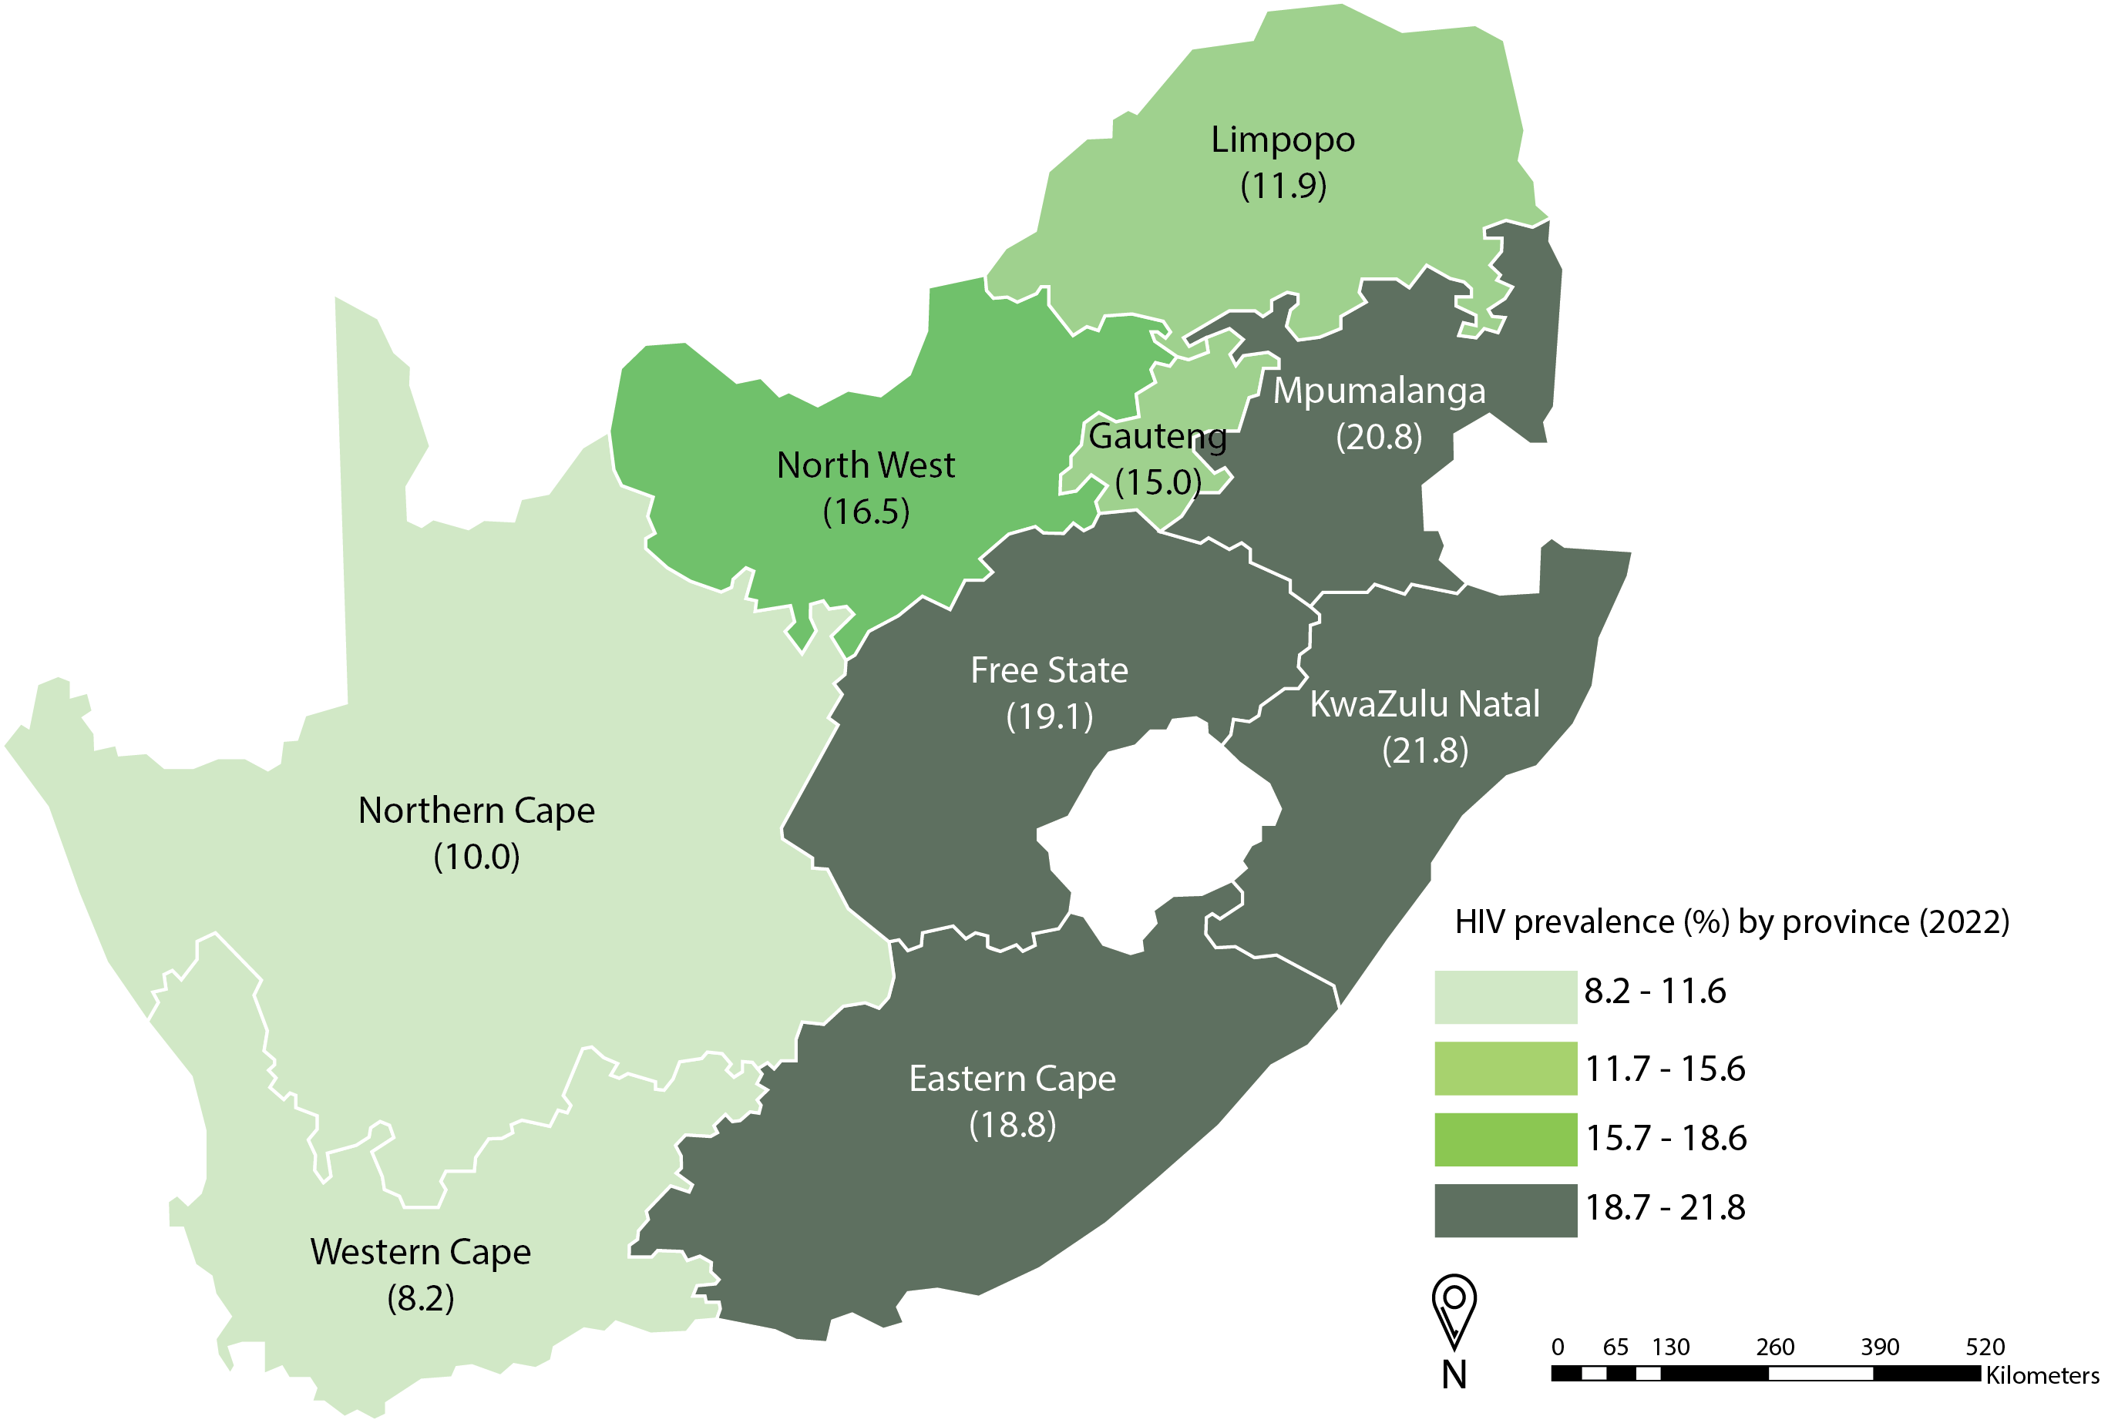
HIV PREVALENCE AMONG PEOPLE AGED 15 YEARS AND OLDER BY PROVINCE, SOUTH AFRICA, 2022

Slide 16
HIV PREVALENCE BY SEX AND AGE,
SOUTH AFRICA, 2022

Slide 17
OVERALL HIV PREVALENCE AMONG MALES,
SOUTH AFRICA, 2017 AND 2022

Slide 18
OVERALL HIV PREVALENCE AMONG FEMALES,
SOUTH AFRICA, 2017 AND 2022

Slide 19
OVERALL HIV PREVALENCE BY AGE,
SOUTH AFRICA, 2017 AND 2022
Age group (years) | 2017 | 2017 | 2022 | 2022
 | HIV-positive (%) | Number of PLHIV | HIV-positive (%) | Number of PLHIV
Total | 14.0 | 7 917 000 | 12.7 | 7 810 000
0–14 | 2.8 | 471 000 | 2.4 | 390 000
15–24 | 7.8 | 754 000 | 5.2 | 533 000
25–49 | 26.3 | 5 581 000 | 22.1 | 5 300 000
50+ | 12.4 | 1 111 000 | 14.0 | 1 588 000
15–49 | 20.6 | 6 335 000 | 17.0 | 5 833 000
15+ | 18.7 | 7 446 000 | 16.3 | 7 420 000

Slide 20
HIV PREVALENCE AMONG 15 YEARS AND OLDER BY PROVINCE, SOUTH AFRICA, 2017 AND 2022
BY

Slide 21
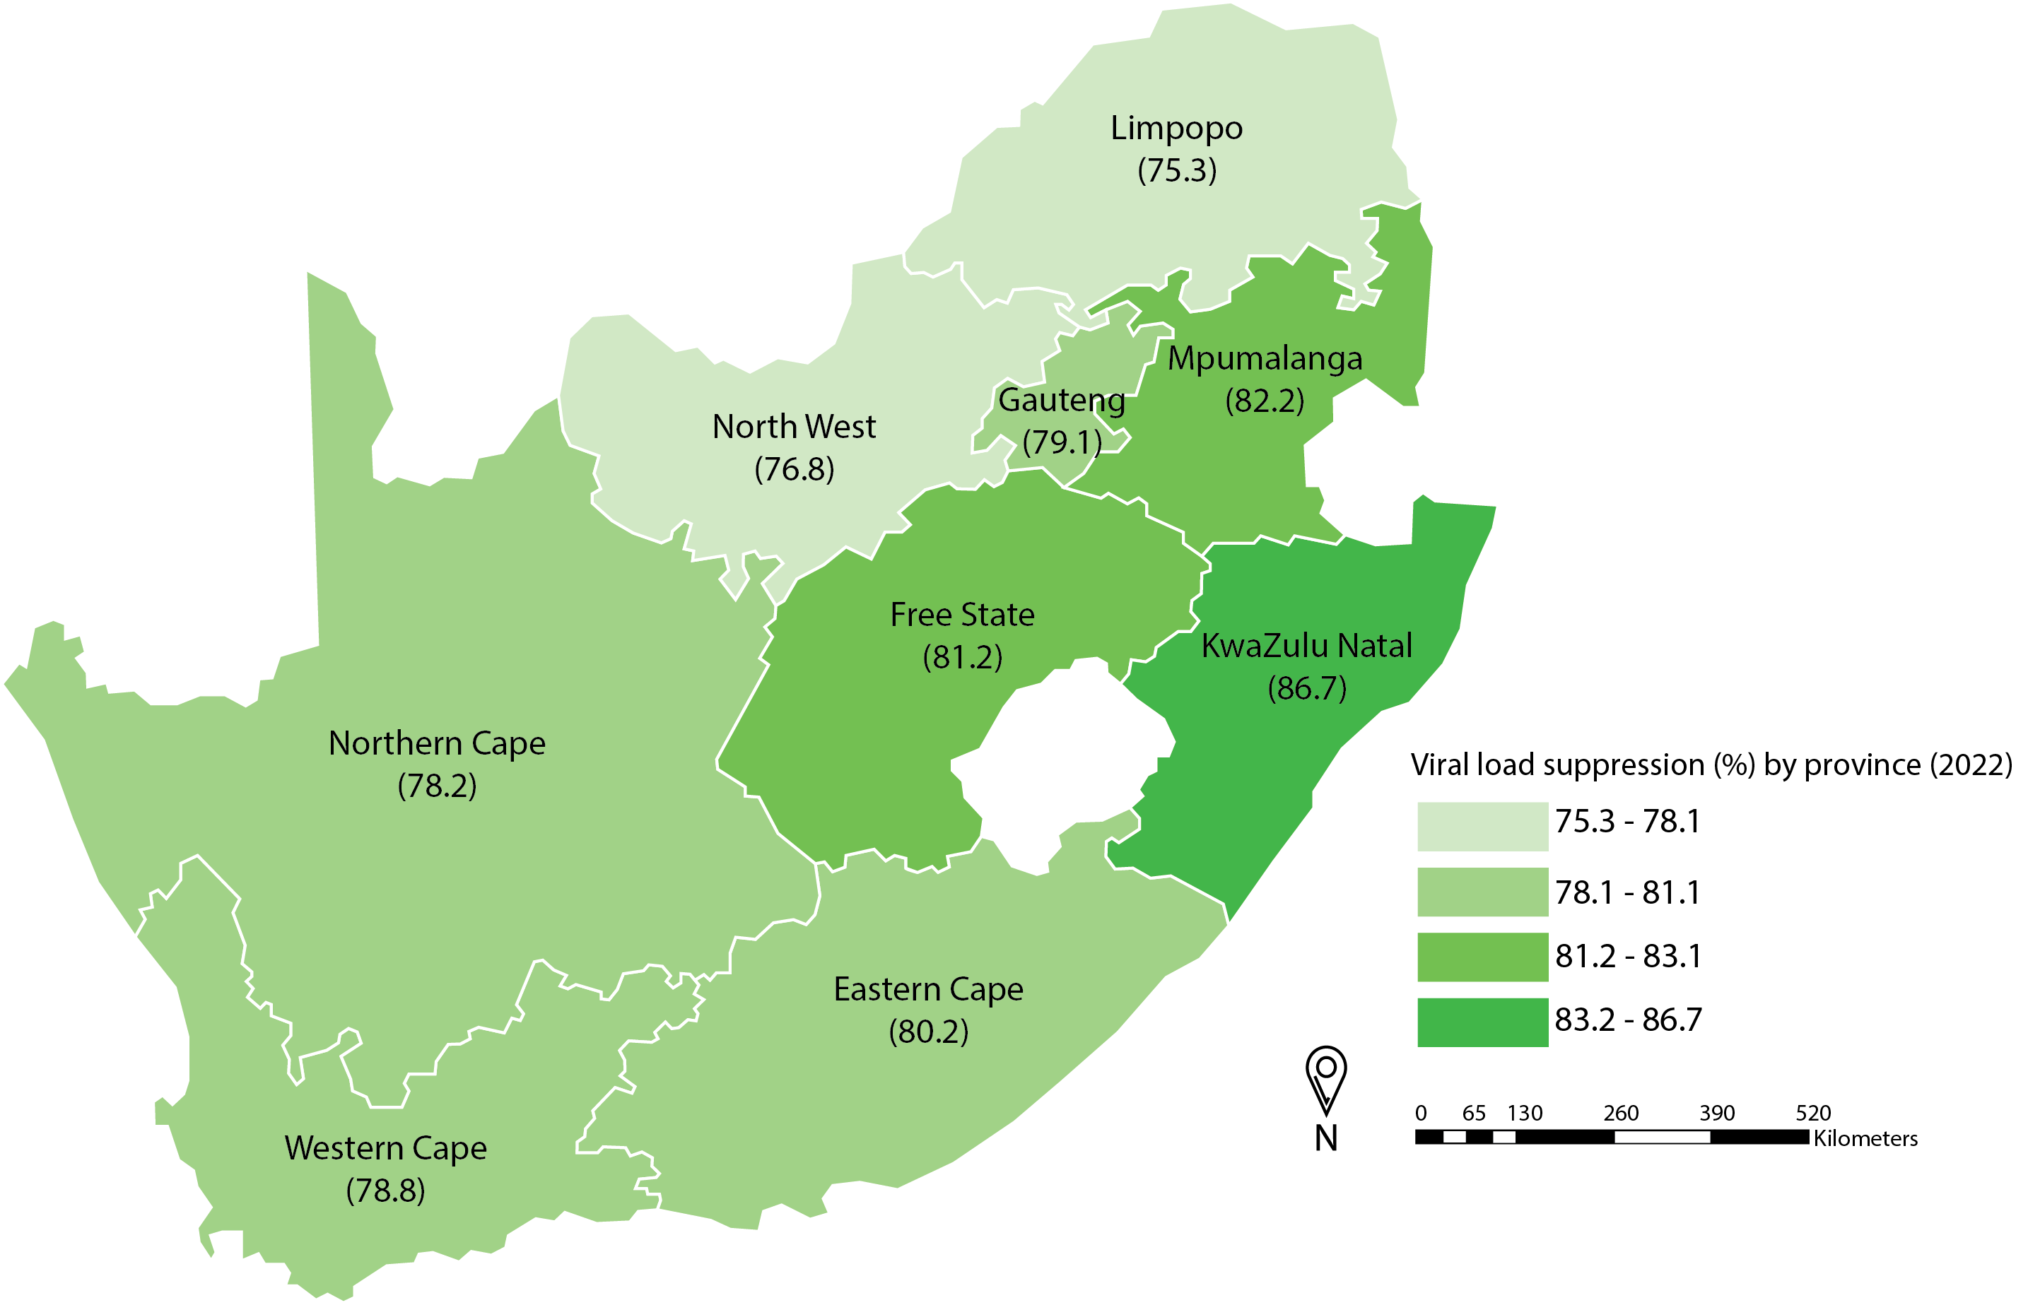
VIRAL LOAD SUPPRESSION AMONG PEOPLE AGED 15 YEARS AND OLDER LIVING WITH HIV BY PROVINCE, SOUTH AFRICA, 2022

Slide 22
VIRAL LOAD SUPPRESSION AMONG PEOPLE LIVING WITH HIV BY AGE AND SEX, SOUTH AFRICA, 2022

Slide 23
VIRAL LOAD SUPPRESSION (15 YEARS AND OLDER) LIVING WITH HIV BY SEX, RACE, AND AGE, SOUTH AFRICA, 2017 AND 2022
 | 2017 |  |  | 2022
 | n | % | 95% CI | n | % | 95% CI
Total | 5 617 | 62.2 | 59.5-64.8 | 7 050 | 81.2 | 78.5-83.6
Sex
Male | 1 468 | 54.1 | 49.1-59.0 | 1 931 | 77.6 | 73.9-80.9
Female | 4 149 | 66.9 | 64.3-69.5 | 5 117 | 82.9 | 79.8-85.7
Age group (years)
15–24 | 736 | 47.7 | 40.9–54.6 | 614 | 70.1 | 63.3–76.1
25–49 | 3 874 | 61.7 | 58.3–64.9 | 4 621 | 80.5 | 76.6–83.9
15–49 | 4 610 | 60.0 | 57.2–62.8 | 5 235 | 79.5 | 75.9–82.7
15+ | 5 617 | 62.2 | 59.5-64.8 | 7 038 | 81.2 | 78.5-83.6

Slide 24




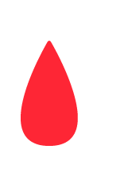
95-95-95 INDICATOR DEFINITIONS
Diagnosed/know status if tested positive in the study and
First 95
Had self-reported being positive or
Tested positive for ART in the study or
Self-reported using ART
On ART
Second 95
Tested positive for ARVs in the study
Self-reported using ART
Virally suppressed
Third 95
Viral load <1000 copies/ml

Slide 25
95-95-95 INDICATORS FOR PEOPLE AGED 15 YEARS AND OLDER LIVING WITH HIV, SOUTH AFRICA, 2022
2022
2017

Slide 26
MALE CIRCUMCISION, SOUTH AFRICA, 2022

Slide 27
CONDOM USE DURING MOST RECENT SEXUAL ENCOUNTER FOR PEOPLE WITH MULTIPLE SEXUAL PARTNERS*, SOUTH AFRICA, 2022
* Who reported having 2 or more partners in past 12 months

Slide 28
CONCLUSIONS
Promising decreases in HIV prevalence, coupled with high community VLS (81%), point to the impact of South Africa’s National HIV Response, with support from the PEPFAR program
Marked progress has been made towards South Africa’s 95–95–95 adult treatment targets:
  90% of adults knew their status, 91% of those diagnosed were on ART, and 94% of those on ART were virally suppressed
  Strategies to improve both HIV diagnosis and ART use are urgently needed to achieve the 2025 national goals.
The HIV epidemic continues to disproportionately affect specific geographical regions and demographic groups, especially Black Africans and women
SABBSM VI data will be used to target HIV programming to address the remaining gaps

Slide 29
NEXT STEPS
Finalise the main study report
Complete the analysis for new HIV infections
Produce summary sheets for provinces and selected districts

Slide 30
CONSORTIUM AND PARTNERS
U.S. Centers for Disease Control and Prevention (CDC)
South African Medical Research Council (SAMRC)
National Institute for Communicable Diseases (NICD)
University of Cape Town (UCT)
National Department of Health (NDoH)
South African National AIDS Council (SANAC)
United Nations Children’s Fund (UNICEF)
United States Agency for International Development (USAID)
Joint United Nations Programme on HIV/AIDS (UNAIDS)

Slide 31
FUNDING SOURCE
President’s Emergency Plan for AIDS Relief (PEPFAR) through the Centers for Disease Control and Prevention (CDC).

Slide 32
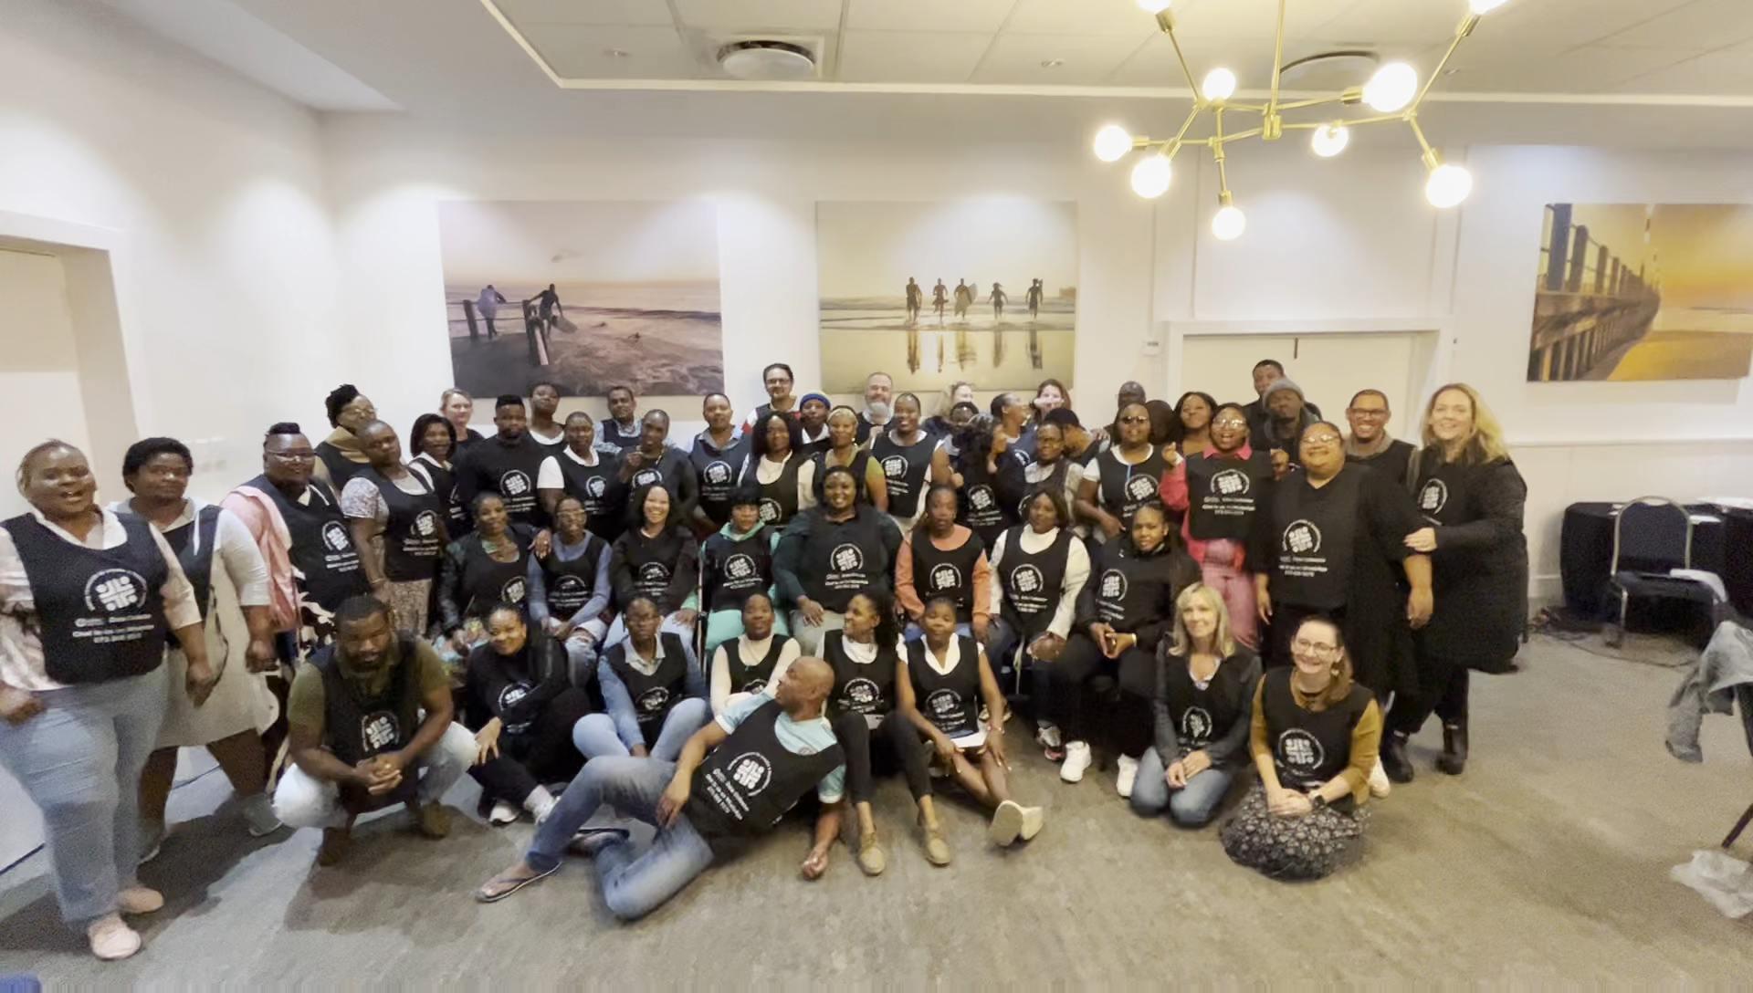
THANK YOU

Slide 33
LIST OF CONTRIBUTORS
Human Sciences Research Council
Name | Role
Prof Khangelani Zuma | Overall Principal Investigator
Prof Leickness Simbayi | Principal Investigator
Dr Nompumelelo Zungu | Principal Investigator
Prof Sizulu Moyo | Principal Investigator
Dr Edmore Marinda | Co-Principal Investigator
Dr Sean Jooste | Co-Principal Investigator
Dr Shandir Ramlagan | Project Director
Dr Musawenkosi Mabaso | Project Director
Dr Lehlogonolo Makola | Overall Project Manager
Mr Johan Van Zyl | Project Manager: Quality Control
Dr Vuyelwa Mehlomakulu | Project Manager: HIV Testing Services
Dr Rindidzani Magobo | Project Manager: Laboratory Testing
Ms Yolande Shean | Communications Manager
Mr Phaleng Maribe | Data Manager
Ms Goitseone Maseko | Statistician
Ms Ronel Sewpaul | Statistician
Dr Inbarani Naidoo | Co-Investigator
Dr Jeremiah Chikovore | Co-Investigator
Mr Adlai Davids | Co-Investigator
Ms Mafanato Maluleke | Co-Investigator/Coordinator
Mr Lesiba Ofentse Molopa | Co-Investigator/Coordinator
U.S. Centers for Disease Control and Prevention (CDC)
Name | Role
Dr Rachael Joseph | Co-Investigator
Dr Pelagia Murangandi | Co-investigator
Ms Nuha Naqvi | Co-investigator
South African Medical Research Council (SAMRC)
Name | Role
Dr Tarylee Reddy | Statistician
Dr Nonhlanhla Yende-Zuma | Statistician
Ms Mikateko Mazinu | Statistician
Ms Yusentha Balakrishna | Statistician
National Institute for Communicable Diseases (NICD)
Name | Role
Prof. Adrian Puren | Co-Investigator
Ms. Beverly Singh | Co-Investigator
Ms Ewalde Cutler | Co-Investigator
Ms Zinhle Brukwe | Co-Investigator
University of Cape Town
Prof Gary Maartens | Co-Investigator
Ms Sandra Castel | Co-Investigator

