Slide 1
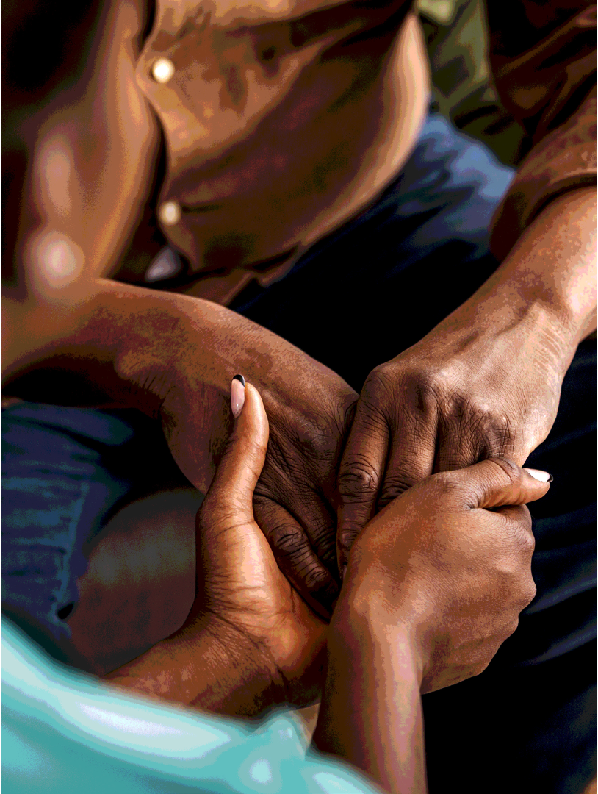



A national skills audit of Community Health Workers and Outreach Team Leaders employed by the National Department of Health
16 February 2024

Slide 2

AIM & OBJECTIVES
Overall Aim
To undertake an audit of the current qualifications and skills profile of Community Health Workers (CHWs) and Outreach Team Leaders (OTLs) deployed in the public health system in South Africa
Objectives
To establish the number and distribution of CHWs and OTLs and their geographical coverage (ratio per uninsured population) at national, provincial, district, subdistrict and ward level
To establish the qualifications of CHWs and OTLs nationally, provincially, and at district level
To identify skills and competencies of CHWs and OTLs
To establish existing CHW training infrastructure and model/s
To identify skills and training gaps among CHWs and OTLs
To determine the views of key provincial managers on models and strategies for meeting CHW and OTL training needs.

Slide 3




METHODOLOGY
Survey among CHWs and OTLs (Structured questionnaire administered telephonically to sampled respondents who consent)
Mixed methods study
Data on OTLs and CHWs at provincial & district level
In-depth interviews with provincial managers via telephone
Notes:
Development of Questionnaires included:
Followed skills audit template – DPSA
Reviewed job scopes of CHWs and OTLs
Shared with TTT for input and approval

Slide 4
SAMPLING
Survey
The Ideal Clinic Database used as sampling frame
Stratified two-stage cluster sampling
  10% of facilities randomly selected per province (n=202 sampled)
  At the facility level, a maximum of 4 CHWs and 1 OTL were randomly selected (808 CHWs and 202 OTLs).
Qualitative interviews
18 provincial managers were purposively selected for interviews through engagement with the NDoH, PDoH, and the CHWTTT
Notes:
Database used for sampling:
Ideal Clinic Database (ICD) was shared with the team in February 2023
The Ideal Clinic database (ICD) and WBPHCOT DHIS database were received. The ICD was used for sampling because it included a larger number of clinics than the DHIS data. The DHIS database included the names and numbers of WBOT teams whereas the ICD was more comprehensive because it included the numbers of CHW positions per clinic, which was used for sampling
Information on the number of CHWs and OTLs per facility from provinces did not come in time hence we used the ICD database
There was a variation between the database and information on the ground – discussed in the rapid appraisal report

Slide 5
RESULTS

Slide 6
NUMBERS OF CHWs and OTLs BY PROVINCE
Province* | CHWs | OTLs
Northern Cape | 1745 | 0
North-West | 5307 | 207
Mpumalanga | 5347 | 200
Limpopo | 7029 | 332
KwaZulu-Natal | 10283 | 352
Gauteng | 5685 | 646
Free State | 2320 | 161
Eastern Cape | 4607 | 336
Western Cape* | - | -
TOTAL | 42323 | 2234
*Data to estimate coverage was not available for the Western Cape province when requested

Slide 7
COVERAGE OF CHWs and OTLs BY PROVINCE
(Numbers per 100 000 uninsured population)
Province* | Number of CHWs per 100 000 uninsured population | Number of OTLs per 100 000 uninsured population
Northern Cape | 156.8 | 0.0
North-West | 142.4 | 5.6
Mpumalanga | 126.9 | 4.7
Limpopo | 123.7 | 5.8
KwaZulu-Natal | 99.1 | 3.4
Free State | 91.8 | 6.4
Eastern Cape | 76.1 | 5.6
Gauteng | 46.1 | 5.2
Western Cape* | - | -
NATIONAL | 81.5 | 4.3
*Data to estimate coverage was not available for the Western Cape province when requested

Slide 8
COVERAGE OF CHWs and OTLs BY PROVINCE
(Numbers per 100 000 uninsured population)
CHWs per 100 000 uninsured population by province
OTLs per 100 000 uninsured population by province

Slide 9
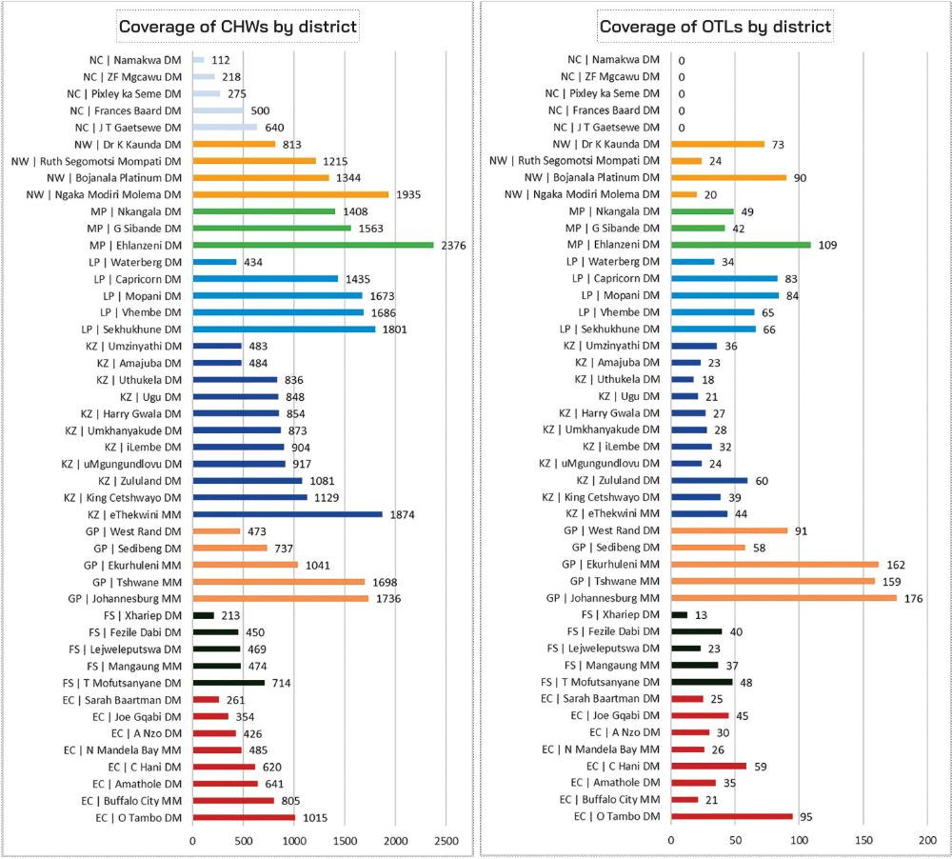
NUMBERS OF CHWs and OTLs BY DISTRICT
Numbers of CHWs
Numbers of OTLs
CHWs
OTLs
Source: Department of Health, October 2023 (No data available for Western Cape at time of analysis)

Slide 10
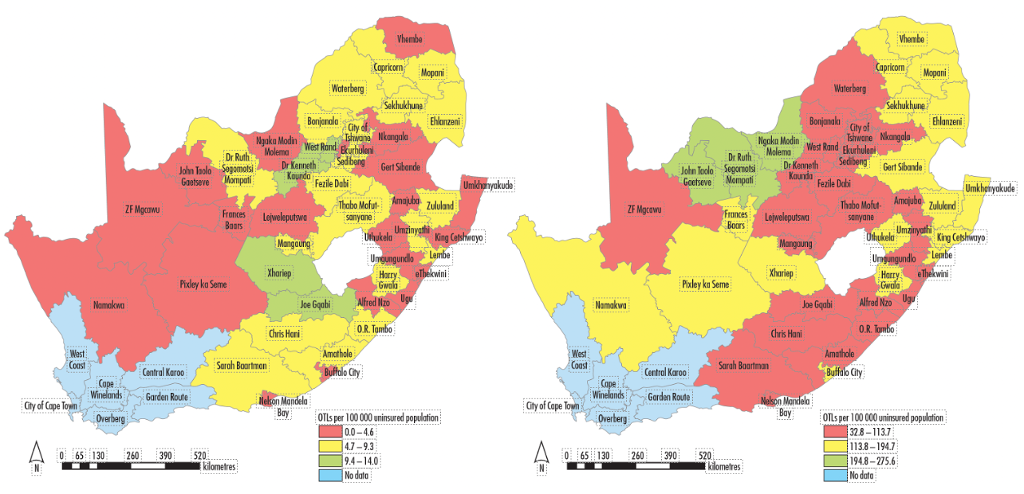
COVERAGE OF CHWs and OTLs BY DISTRICT
(Numbers per 100 000 uninsured population)
OTLs per 100 000 uninsured population
CHWs per 100 000 uninsured population
OTLs per 100 000 uninsured population by province
CHWs per 100 000 uninsured population by province

Slide 11
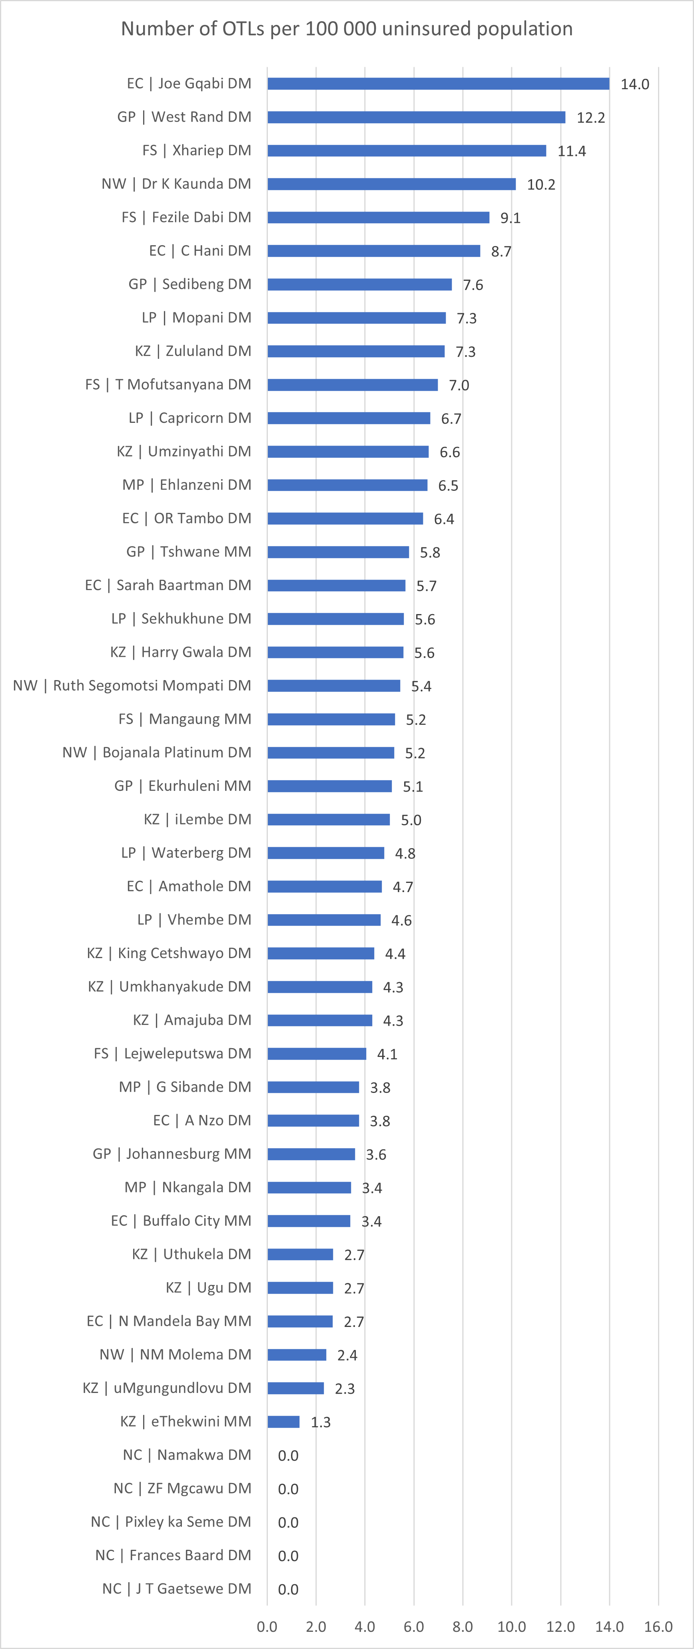
OTL COVERAGE BY DISTRICT:
Numbers of OTLs per 100 000 Uninsured Population
(Ordered from highest to lowest)

Slide 12
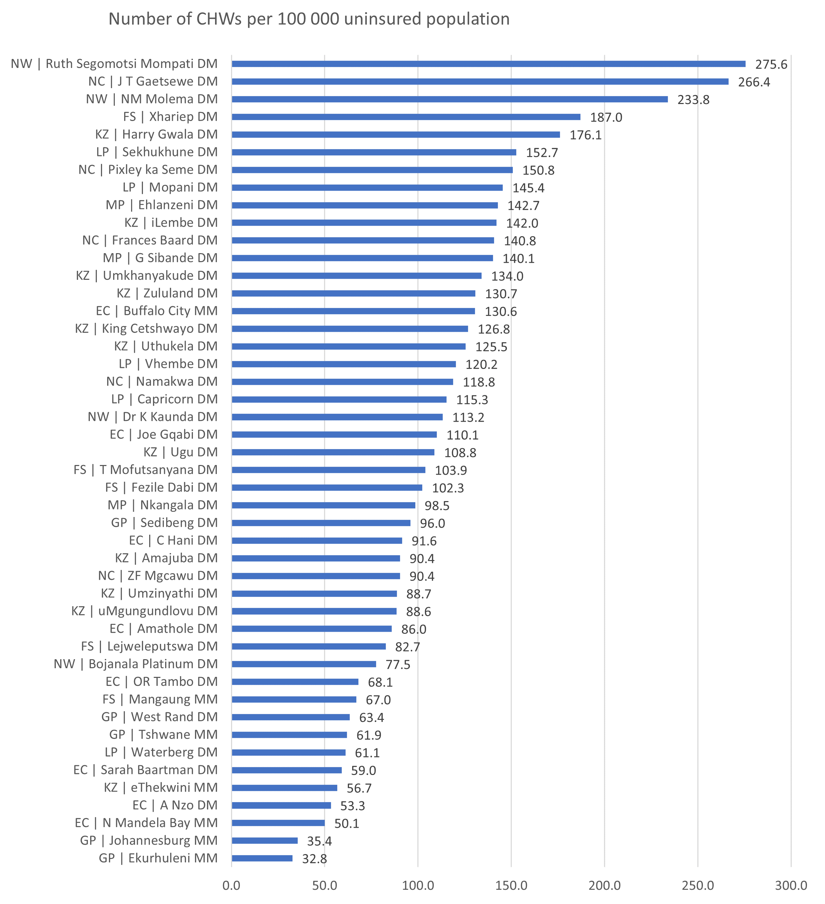
CHW COVERAGE BY DISTRICT:
Numbers of CHWs per 100 000 Uninsured Population
(Ordered from highest to lowest)

Slide 13
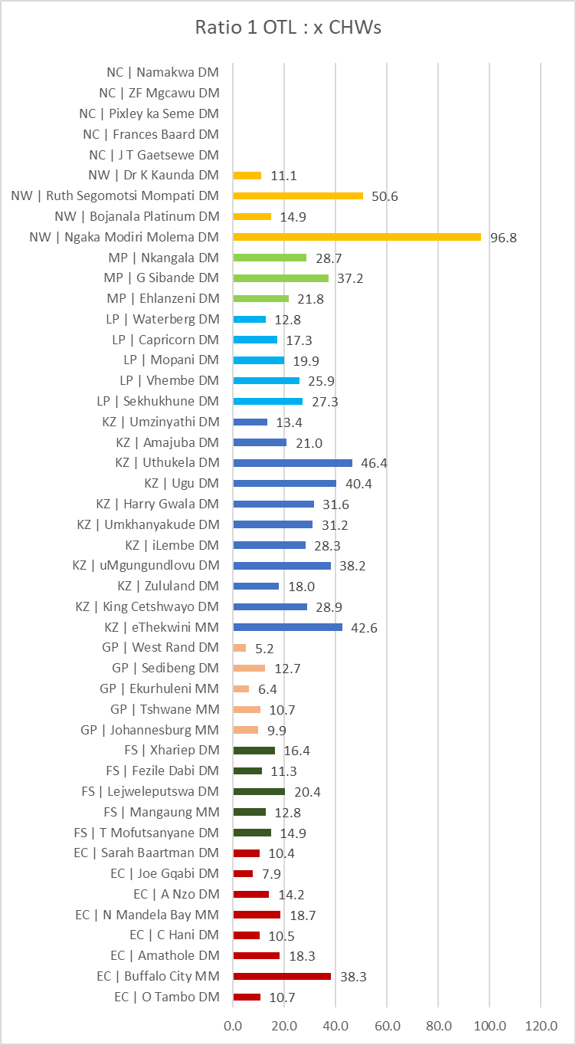
THE RATIO OF CHWs TO OTLs
Number of CHWs to 1 OTL

Slide 14
SURVEY DEMOGRAPHICS
The average age of the CHWs and OTLs were 46 years
Most of the sample was female (89.8%)
Black African (95.6%)
Almost half (47.7%) of the sample had a Matric qualification
OTLs had higher education levels than CHWs
61.5% of OTLs had a tertiary level qualification
37.5% of CHWs - highest education level was between Grades 8-11

Slide 15
AGE GROUP OF CHWs and OTLs BY PROVINCE

Slide 19
REASONS FOR NOT COMPLETING TRAINING AMONG CHWs and OTLs
 | Foundation Phase NDOH Training (%) |  | Phase 1 NDOH Training (%) |  | Phase 2 NDOH Training (%) |  | Occupational Certificate: Health Promotion Officer (%)
REASON FOR NOT COMPLETING TRAINING | OTL | CHW | OTL | CHW | OTL | CHW | OTL | CHW
Training has not yet been offered to me | 66.7 | 92.1 | 71.7 | 88.7 | 79.5 | 91.6 | 92.2 | 94.1
I have received other training and so do not need this particular training | 16.7 | 0.0 | 17.4 | 0.5 | 8.2 | 0.5 | 5.2 | 1.3
I have no transport/ have logistics difficulties to get to the venue | 0.0 | 1.6 | 0.0 | 1.5 | 1.4 | 1.8 | 0.0 | 0.8
I have no time to attend training | 2.8 | 0.8 | 2.2 | 1.0 | 2.7 | 0.5 | 1.3 | 0.5
Other | 13.9 | 5.6 | 8.7 | 8.2 | 8.2 | 5.5 | 1.3 | 3.3

Slide 20
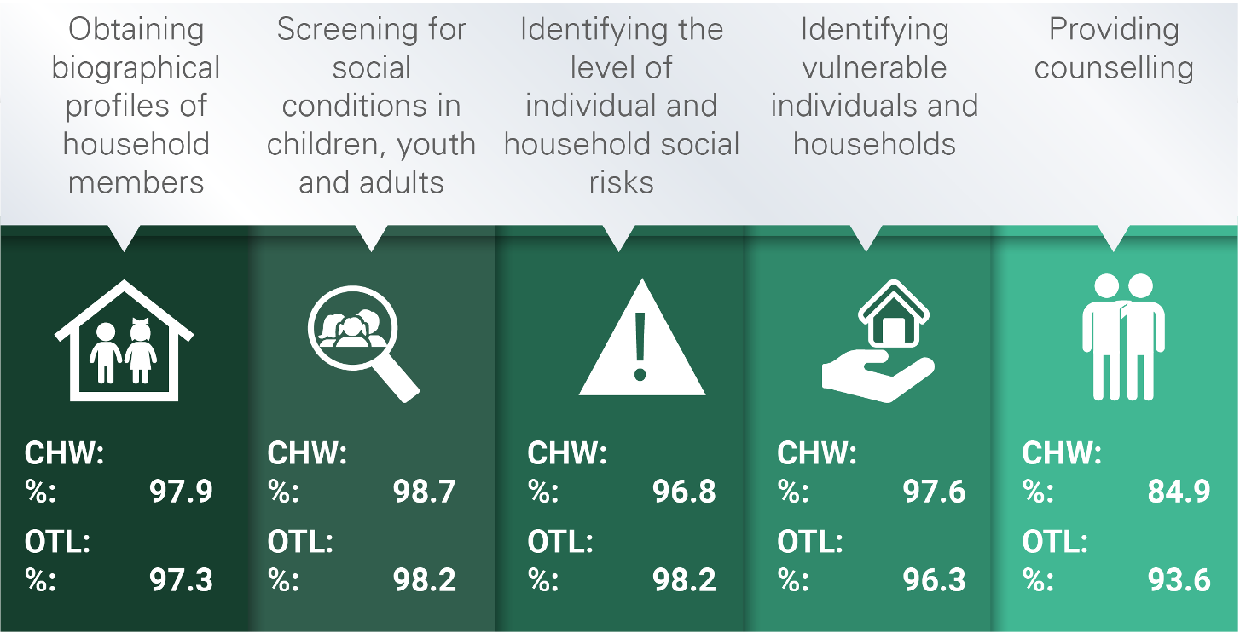
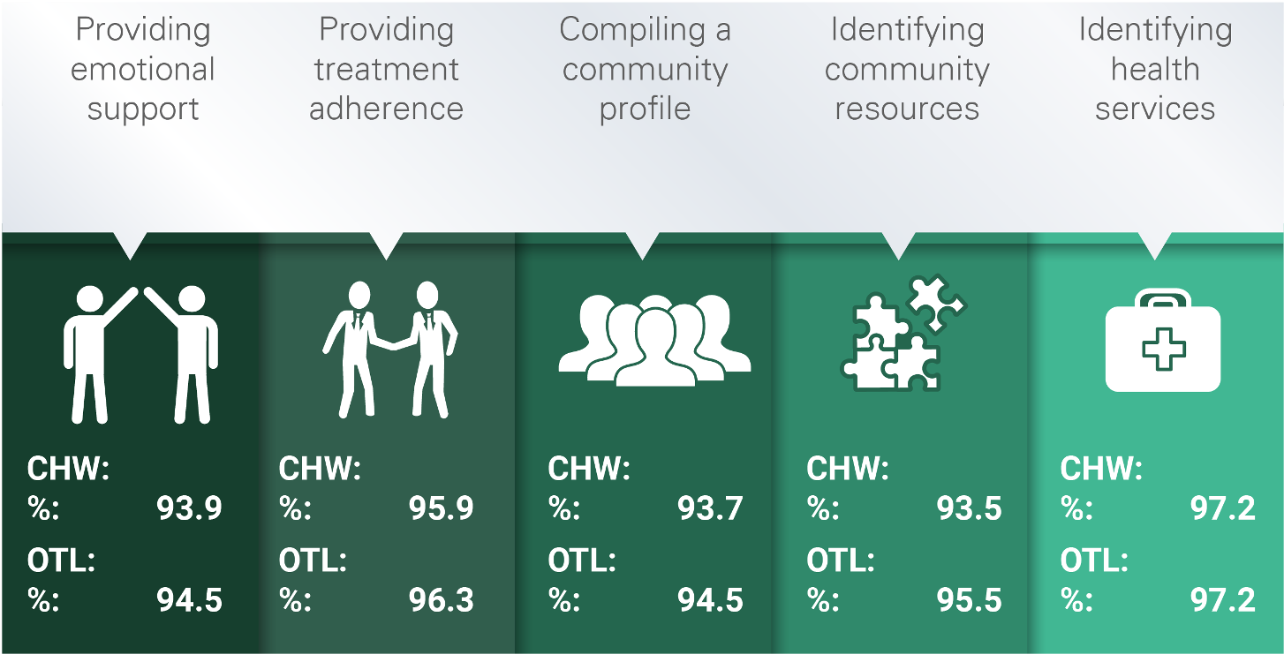
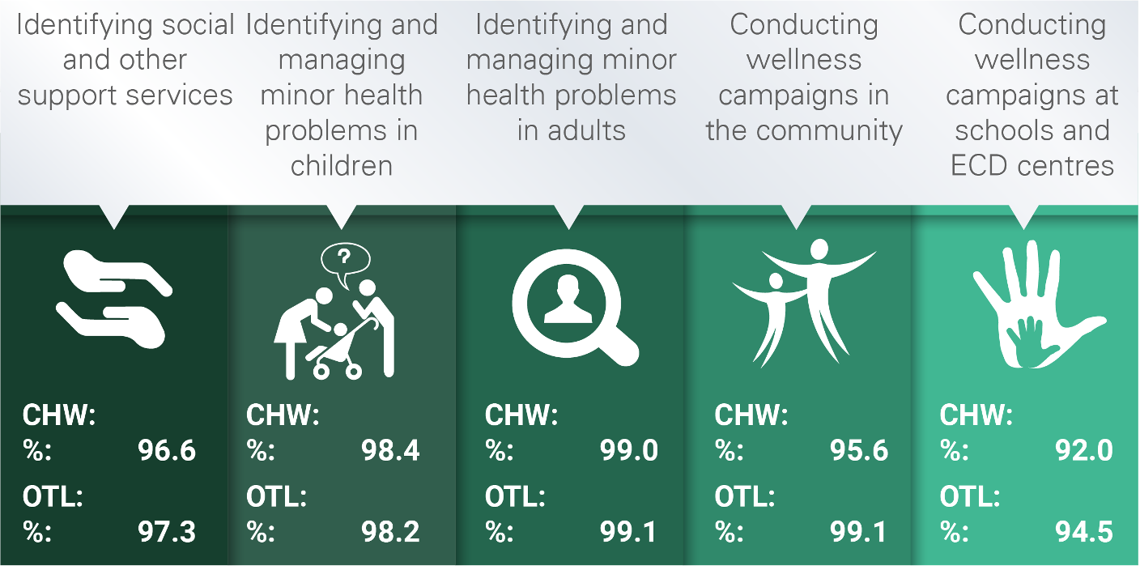
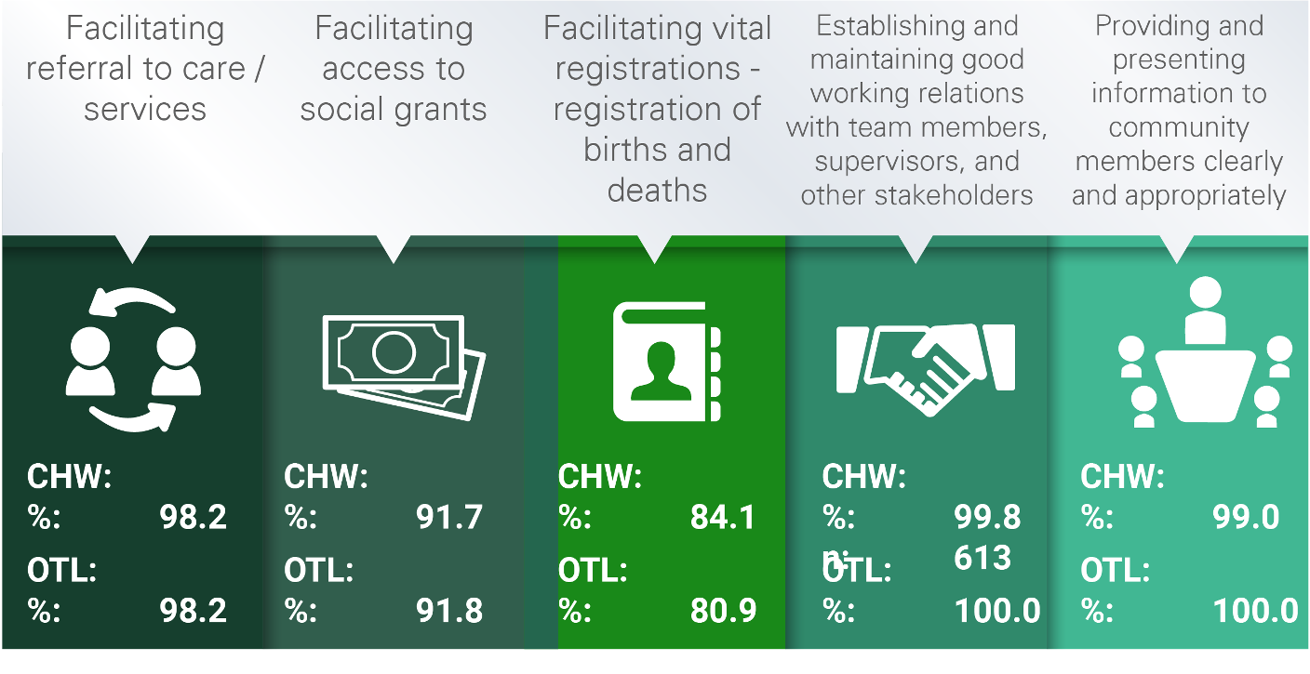
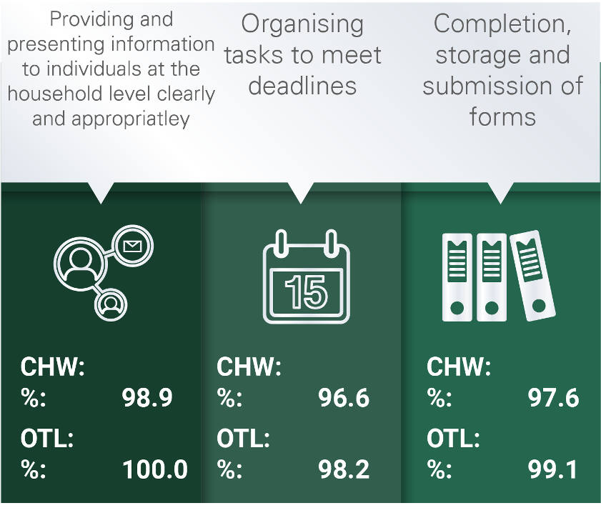
TASKS UNDERTAKEN BY CHWs and OTLs

Slide 21
SKILLS, COMPETENCIES AND PROFICIENCY
Most CHWs were skilled in providing education supporting healthy behaviours and facilitating appropriate home care and distribution of health promotion material in areas of Maternal, Child and Women’s Health, HIV, TB and other communicable diseases, chronic and non-communicable diseases
Less than 80% reported being skilled in the areas of substance use and violence and injury
Overall, over 85% of CHWs rated themselves as competent, advanced, or expert and over 50% reported having advanced or expert-level proficiency in tasks performed
OTLs rated themselves as competent, advanced, and experts in most tasks, 4.6% reported having basic skills and proficiency in preparing weekly/ monthly reports

Slide 22
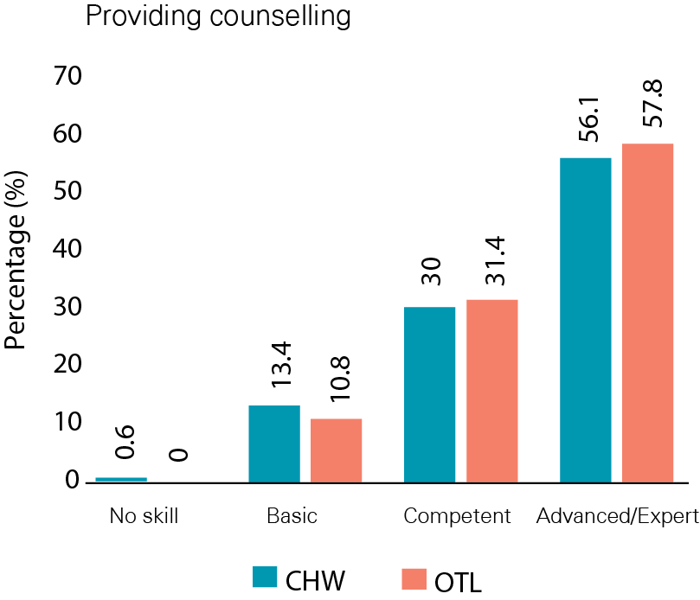
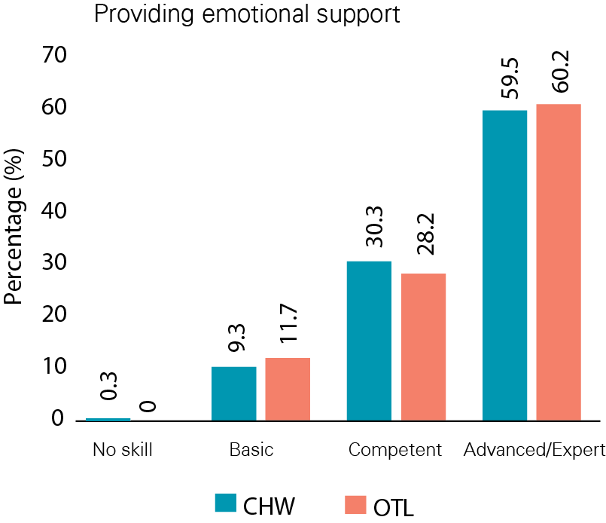
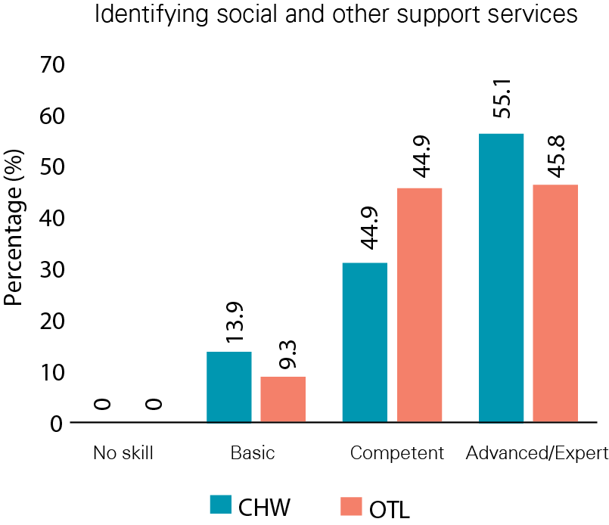
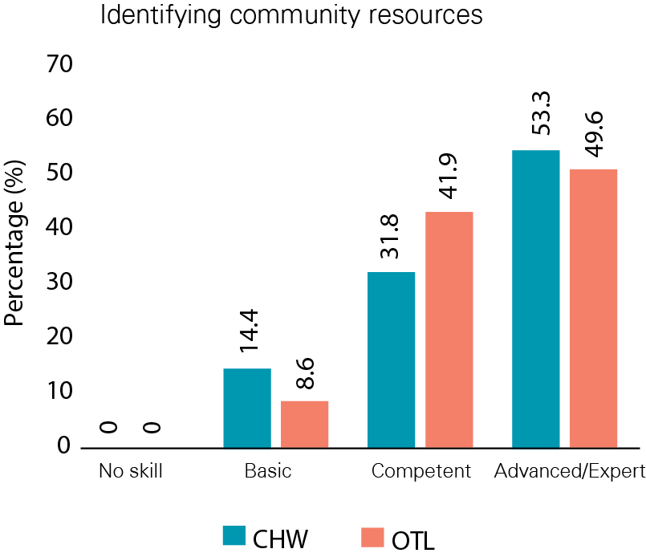
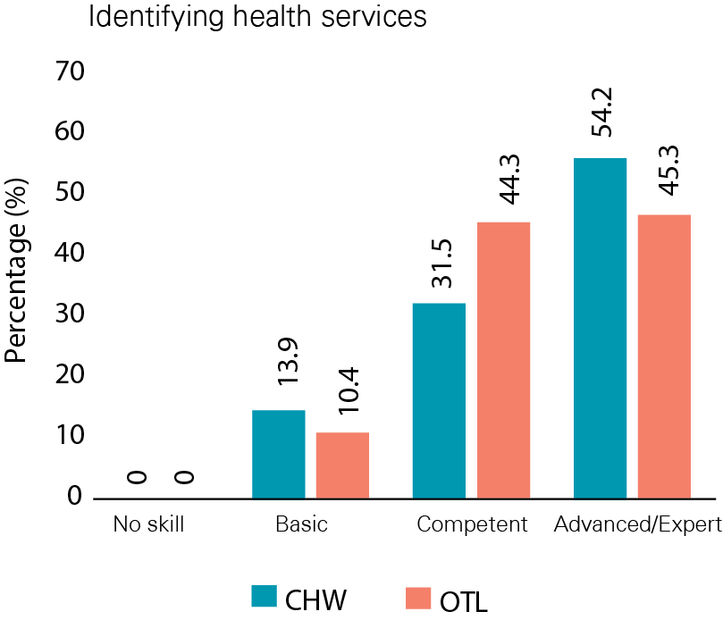
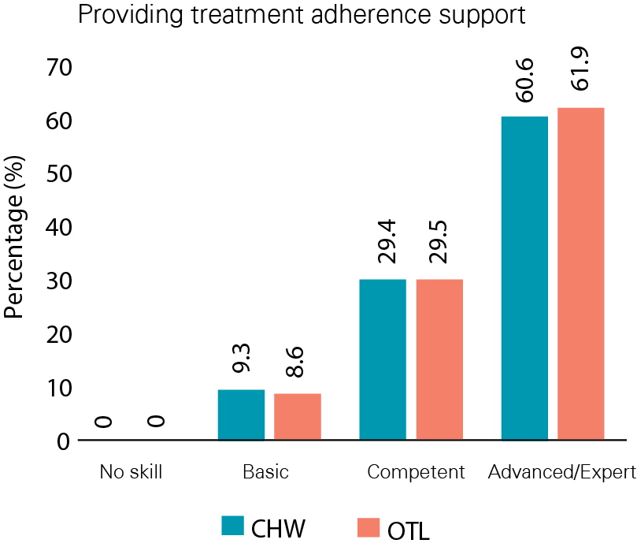
PROFICIENCY RATINGS BY OTLs: MANAGEMENT AND LEADERSHIP
COUNSELLING AND IDENTIFYING SUPPORT SERVICES

Slide 23
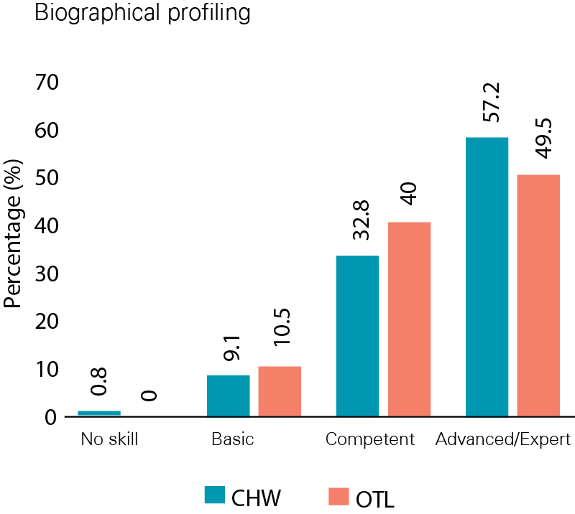
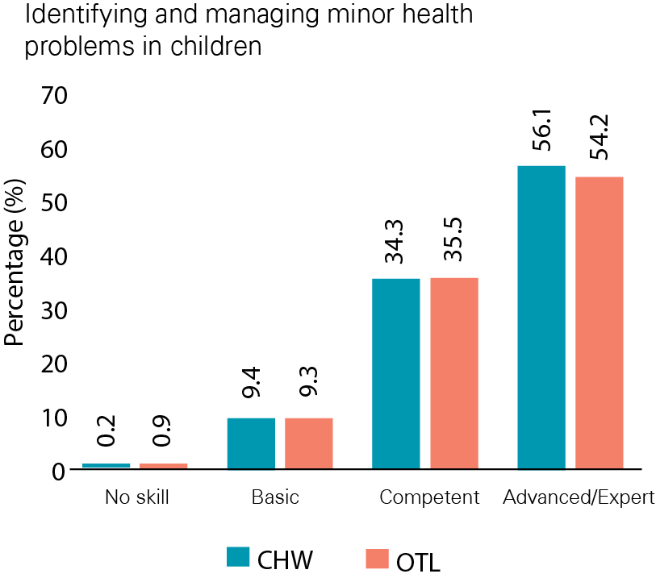
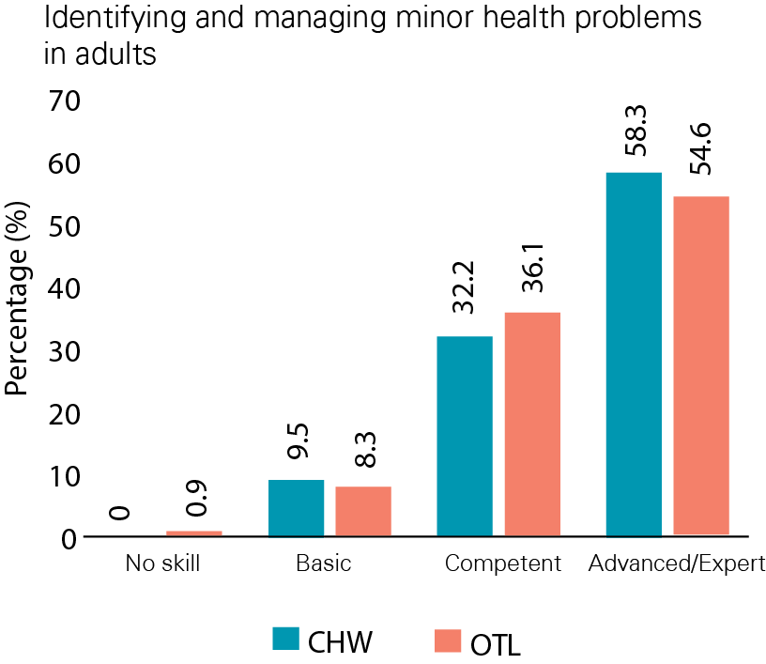
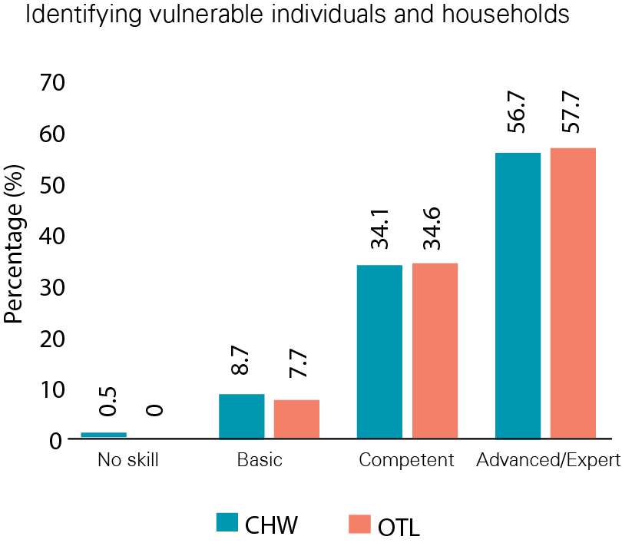
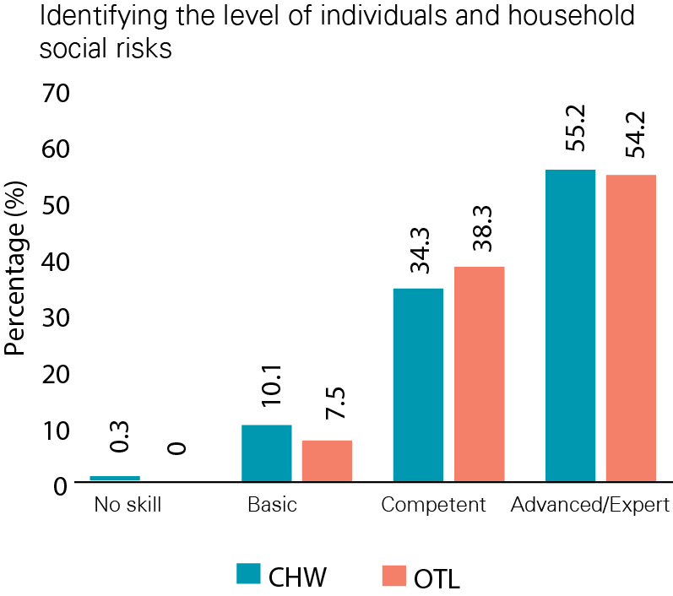
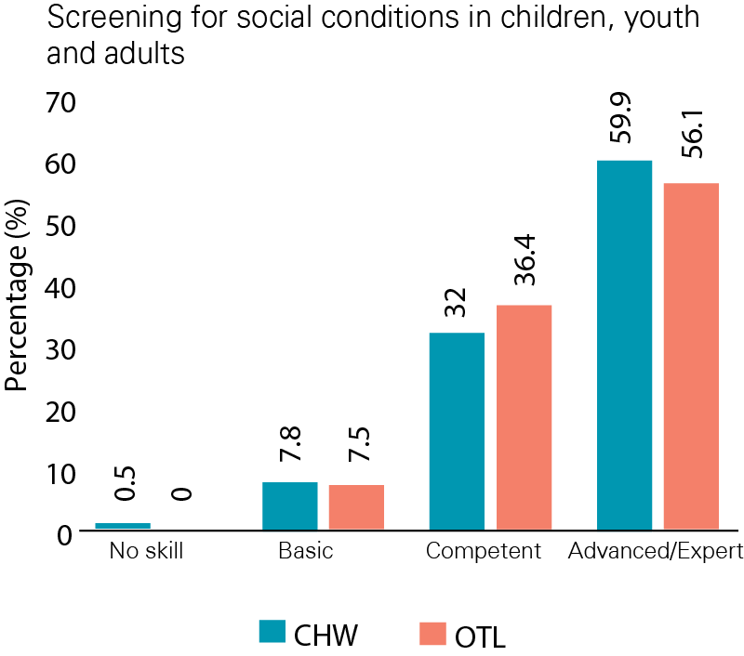
PROFICIENCY RATINGS BY OTLs: MANAGEMENT AND LEADERSHIP
HOUSEHOLD AND INDIVIDUAL LEVEL PROFILING

Slide 24
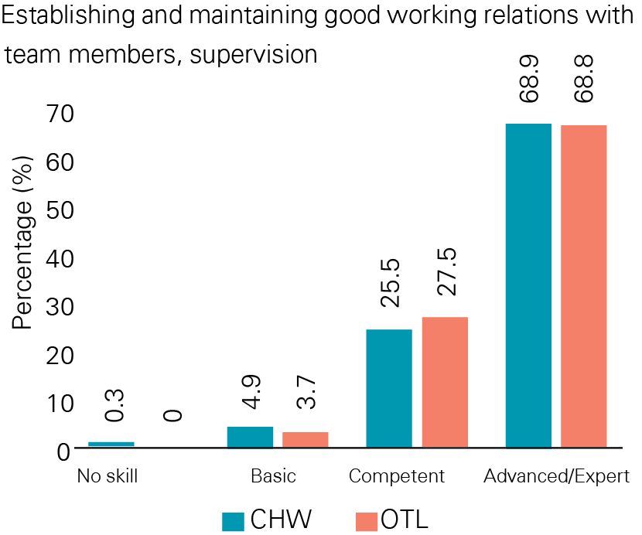
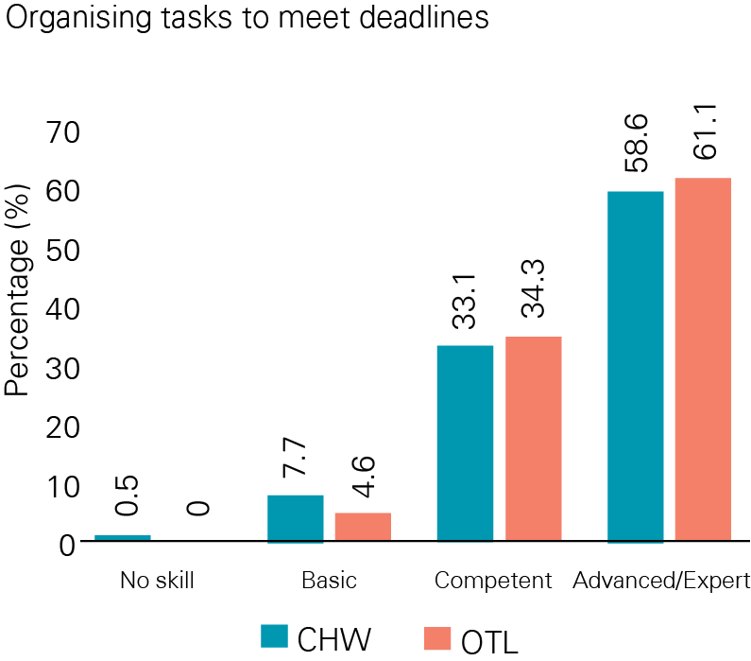
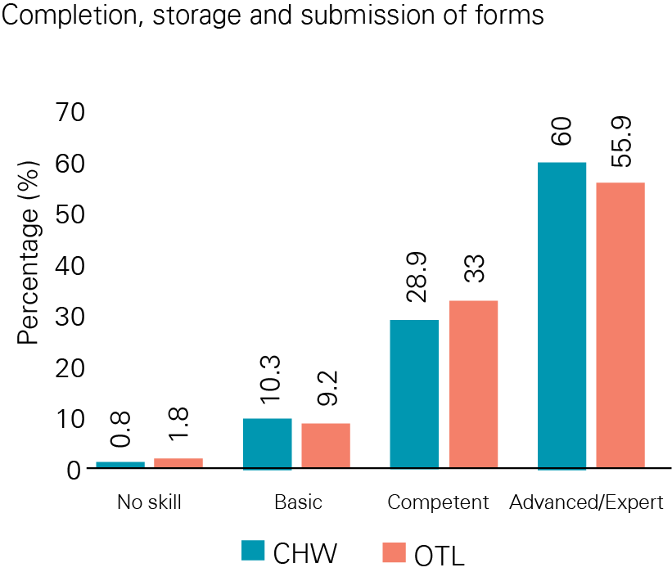
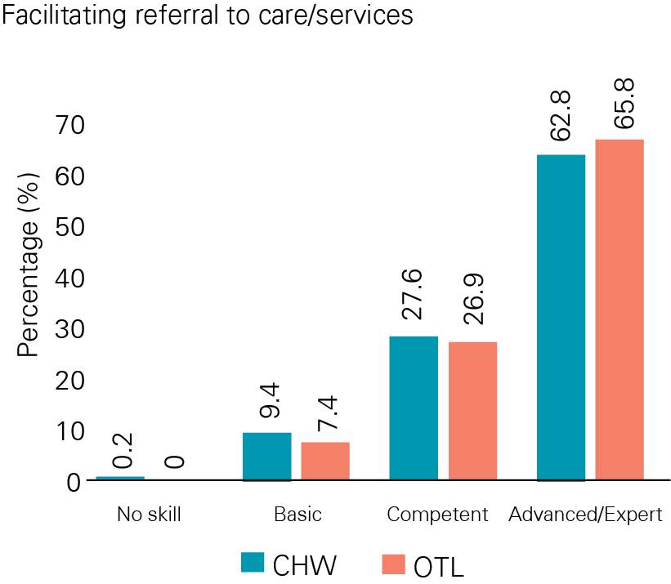
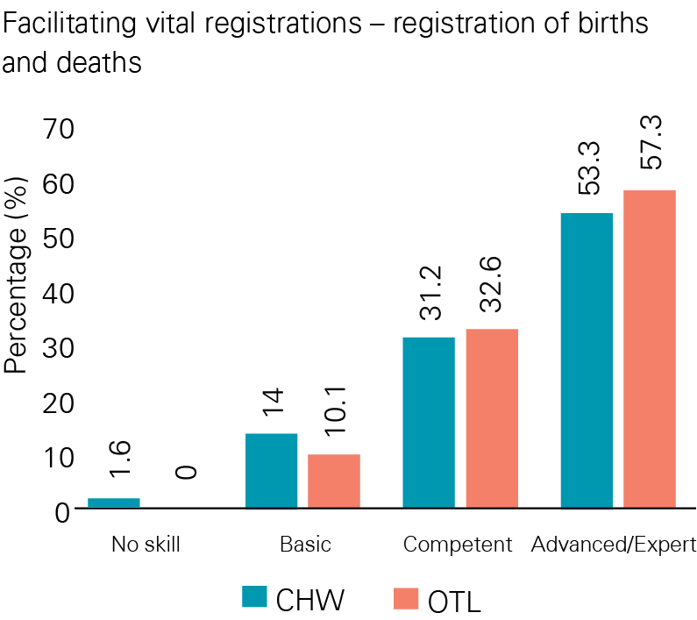
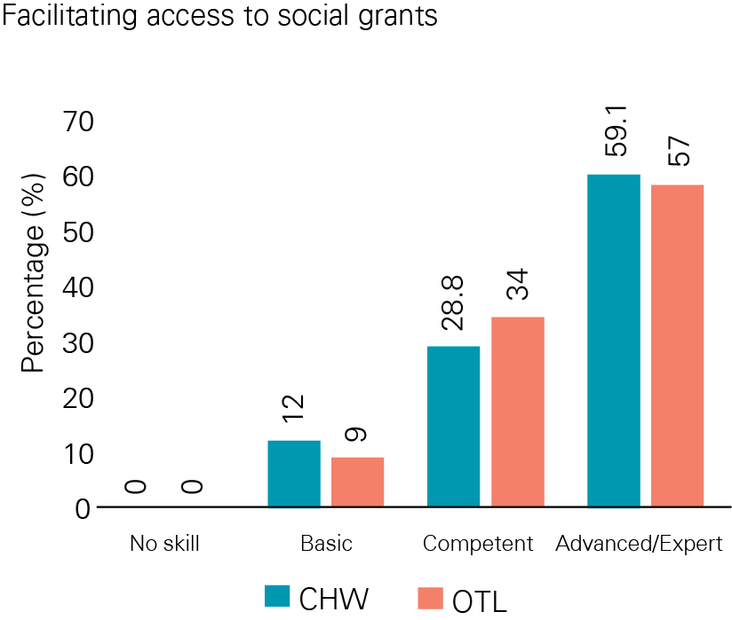
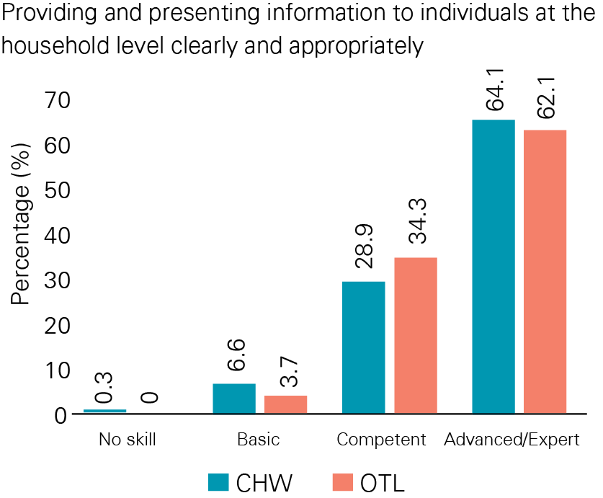
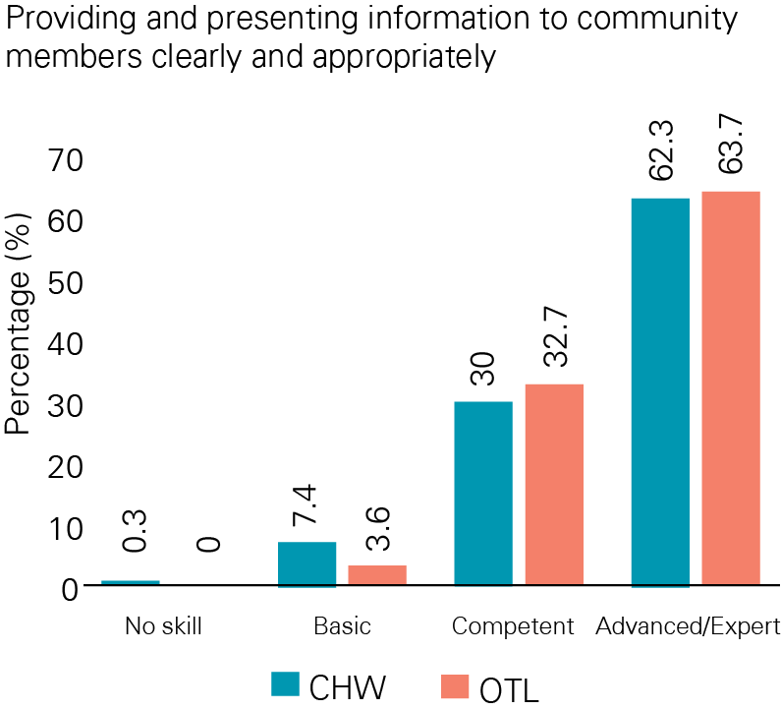
PROFICIENCY RATINGS BY OTLs: MANAGEMENT AND LEADERSHIP
COMMUNICATION, TEAMWORK & ADMINISTRATION

Slide 25
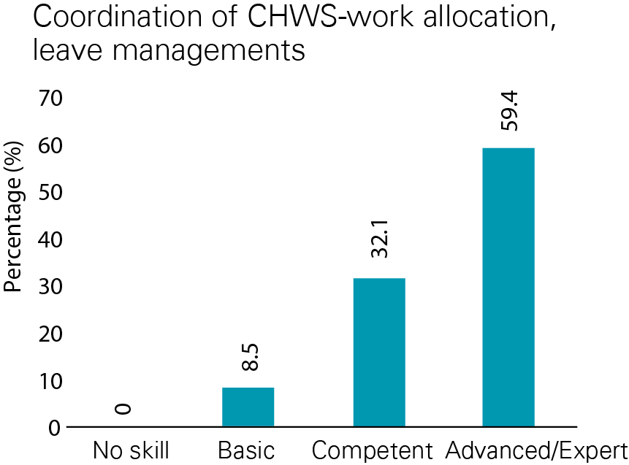
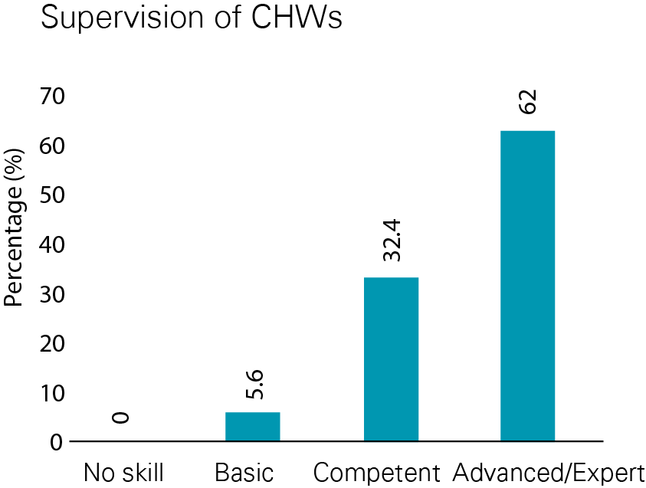
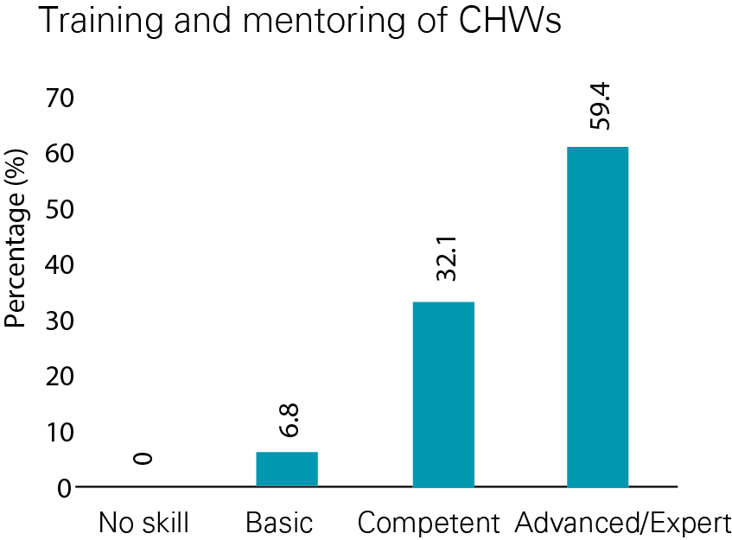
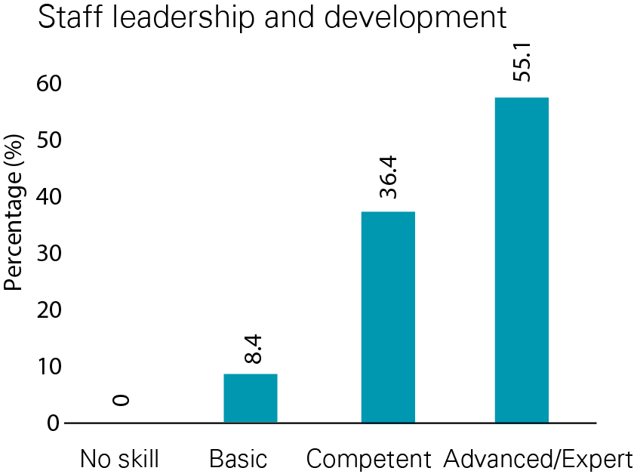
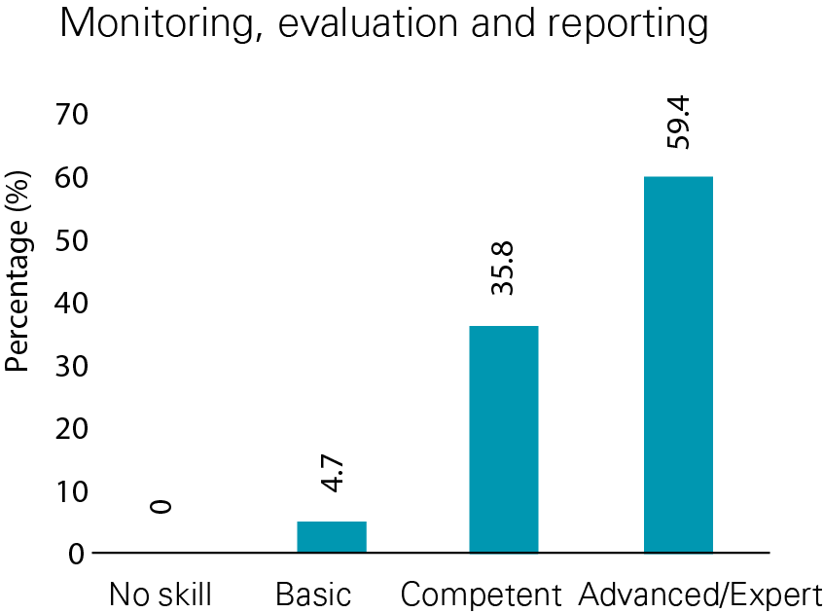
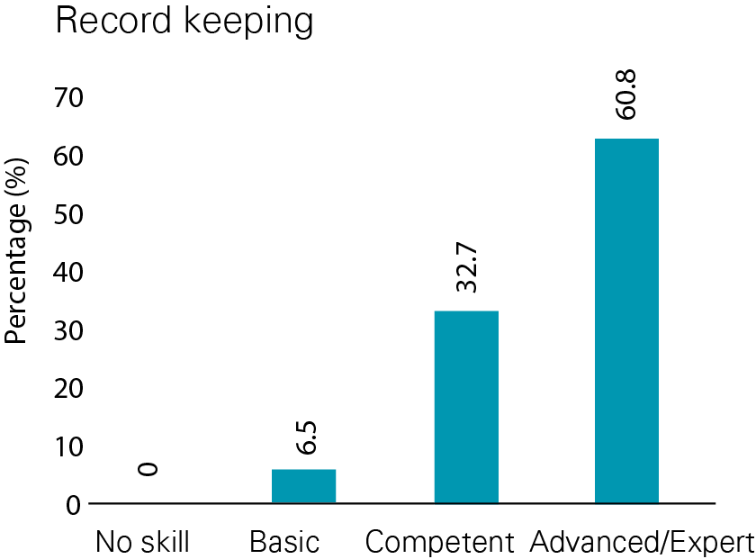
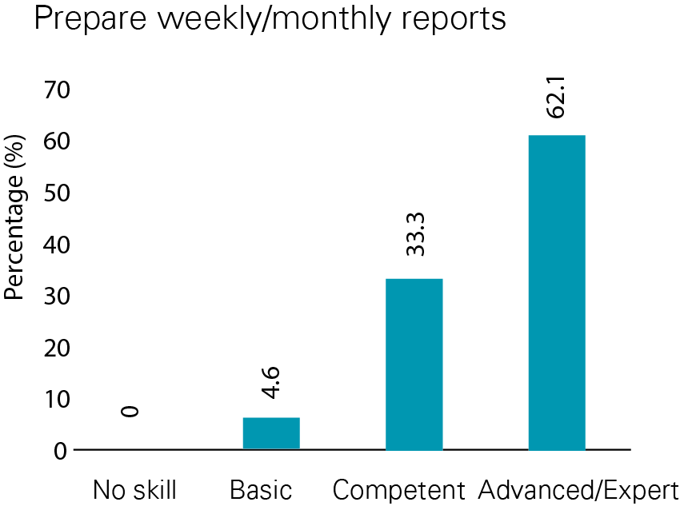
PROFICIENCY RATINGS BY OTLs: CLINICAL SKILLS
OTLs: MANAGEMENT,LEADERSHIP & ADMNISTRATION

Slide 26
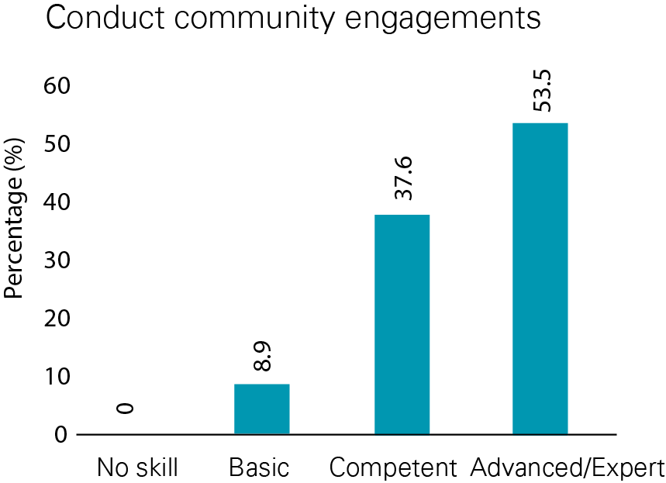
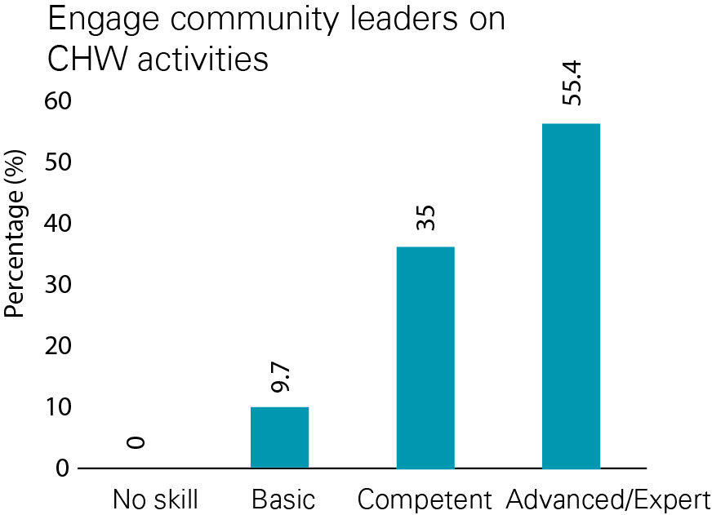
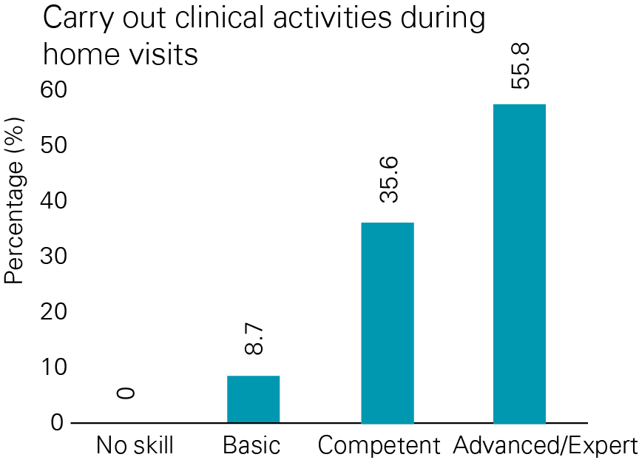
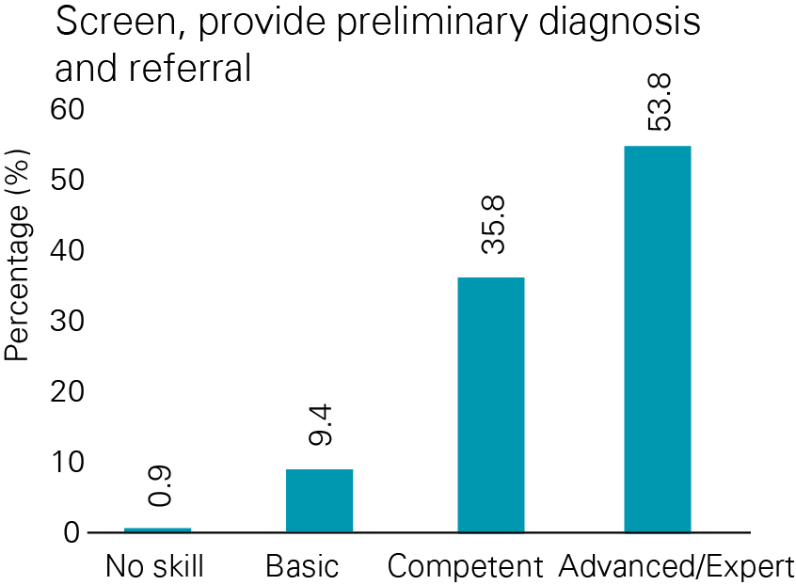
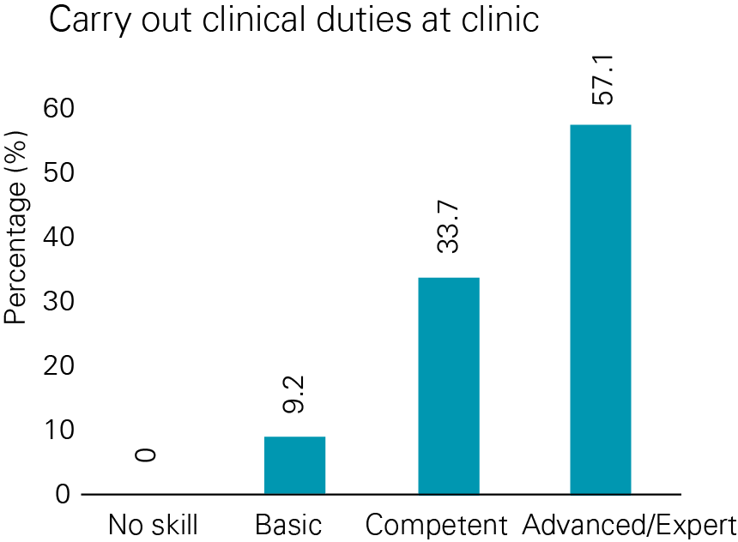
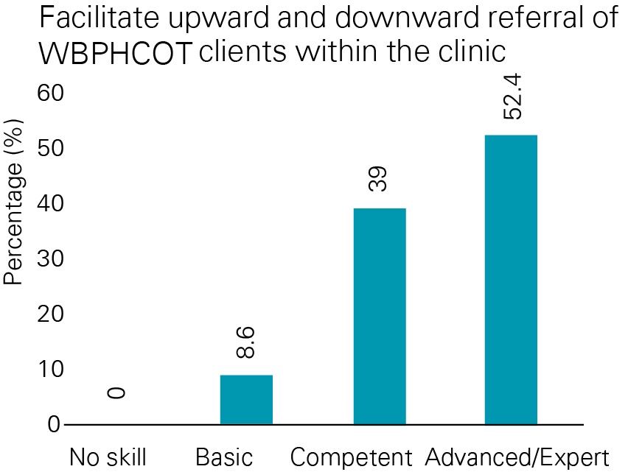
OTLs: COMMUNITY ENGAGEMENT
OTLs: CLINICAL SKILLS

Slide 27
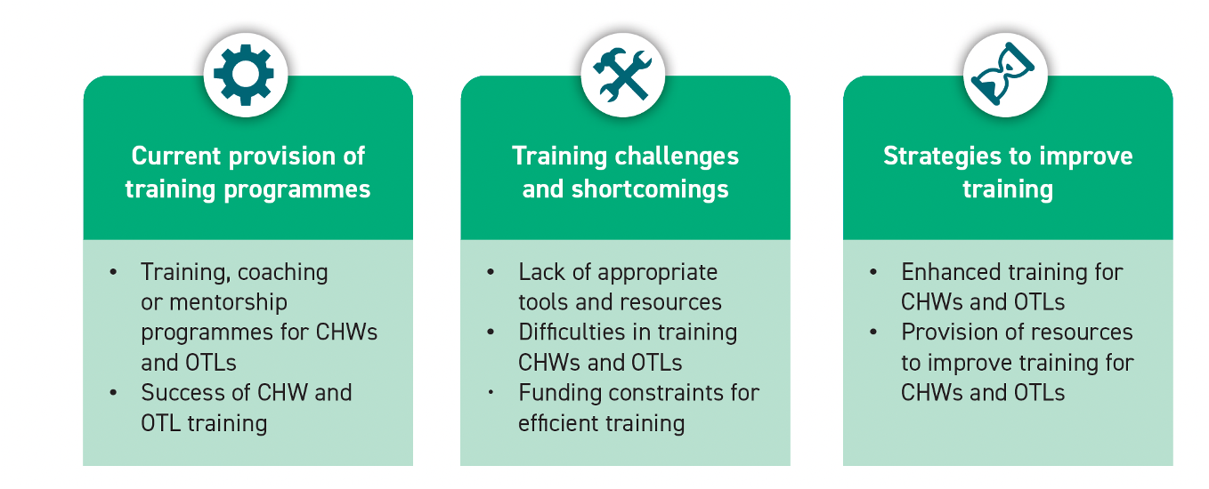
QUALITATIVE INTERVIEW FINDINGS: THEMES AND SUB-THEMES
THEMES AND SUB-THEMES FROM INTERVIEWS WITH KEY PROVINCIAL MANAGERS
15 in-depth interviews completed in 8 provinces.
Western Cape was not available at time of fieldwork.
Notes:
LP – 1 (other potential participants were not available)
WC – 0 (not available)

Slide 28




QUALITATIVE THEME 1: CURRENT PROVISION OF THE TRAINING PROGRAM
NDOH is the primary provider of training
  Collaboration with other institutions and government departments
Training follows a cascade model where CHWs are trained by OTLs, who are trained by master trainers, and the master trainers are trained by RTC managers
Foundation Phase training regarded as “true training”, after which the training is passed onto OTLs to conduct work-based skills training
In-house programs focus on specific topics
  Some may receive training for your NCD. They will be able to screen the diabetes, hypertension, mental health and refer accordingly. So, all of them are standardized, but within that very same group we then have a different set of skills that enables them to cut across different programs and offer support your maternal health, your child health, your post-natal health.
Overall, CHW and OTL training were seen as beneficial and appropriate for the implementation of ART programmes, improvement in health education, and reporting to the Health Promotion units.

Slide 29




QUALITATIVE THEME 2: CHALLENGES AND SHORTCOMINGS
Lack of training material and equipment required for practical training
…stationery is not enough for us and them …also the equipment, each one should be able to have some basic equipment with them…they must have your thermometer, your own BP machine, and your scale that can be put in a bag, they must also be having their sanitizers…So, they need to have the basic equipment and the supplies that they need
Insufficient number of trainers across provinces
I think the other barrier to training is insufficient training facilitators, your master trainers…Currently, the province only has around 5 master trainers, and if you look at a group of xxxx community health workers that's too little to be able to make the progress you want…
Literacy levels and educational qualifications of CHWs
  …sometimes where the program will be CHWs with the OTL, it’s important to remember that there is a vast difference in academic capability, so the CHW may have got matric and the OTL might be a professional nurse with a four-year qualification so to get a curriculum that matches both of those groups.
Funding constraints
“…we don’t even have specific funding that is set aside for those training and developments of the CHW. We don’t even have special funding that is set aside for the OTL, they’re all squashed within what is affordable and doable at a particular point in time, and if there is any funding that we can source from the partners in the health (sector)”

Slide 30



QUALITATIVE THEME 3: STRATEGIES TO IMPROVE TRAINING
Practical parts of training to receive greater attention
…they don't give that much time into the practical part…Tomorrow when you get back to your facility, this is what you will do. It's just sort of theory, but I think it needs another time where we can do more practice to make sure that they can apply knowledge learned when it comes to practice
Adequate attention to training needs of OTLs
  ...the OTLs are mostly professional nurses or enrolled nurses…communication skills are very important for us to bridge that gap…and then enable decision-making instead of us making decisions on behalf of the patient…….
Adequate and appropriate resources including budget for training
  … some …….would not follow, you know they would be very slow to learn. They will not understand complex issues or definitions. You would have to explain…. most of the training material should be now transcribed (translated) in isiZulu, for the illiterate ones to be able to learn
Enhanced mentoring and training
  …that supervisory level, management skills, leadership skills, district management all those issues they need more management skills. Also, this mentorship, they need to be mentored. When there is no one mentoring them when they are out in the community, they will end up doing… procedures that are not in the guidelines. So, all those, they need a lot of mentoring and a lot of training

Slide 31
CONCLUDING REMARKS
Distribution of CHWs varies across South Africa
  Highest coverage in Ruth Segomotsi Mompati DM (North-West), lowest in Ekurhuleni MM (Gauteng)
  Relatively low coverage in the Eastern Cape, a largely rural province, and especially in Alfred Nzo and Sarah Baartman districts
Level of education
  In the survey sample 50% of CHWs had a matric level of education
  Two-thirds of OTLs had a diploma
Older cohort of CHWs and OTLs
  12.2 % CHWs and 7.3% OTLs <35 years old
High self-ratings of competencies
  Most CHWs had many years of experience
  Higher self-ratings in those who had received training
Skills gaps
  Violence/injury competency
  Administrative and leadership skills among OTLs
  English language is barrier->50% requested to complete the survey in their local language
Training
  Allow adequate time for practical training
  Increase focus on training of OTLs /Providing training in leadership for OTLs
  Separating CHWs and OTLs during training
  Dedicated training budgets
  Provide adequate and updated training materials including translated materials

Slide 32
LIMITATIONS
Self-reported skills audits are subject to social-desirability bias
Challenges with telephonically administered interviews included
network instability and connectivity
in some facilities a single telephone was used to conduct multiple interviews which may have compromised privacy
Initially all instruments were in English, but had to be translated to the vernacular
Ethics approval at District level were not received in some districts in the Western Cape and in Gauteng
Qualitative data was not able to be collected in the Western Cape
CHW/OTL coverage was not able to be provided in the Western Cape
The data on the number of CHWs and OTLs per district were not readily available from provinces for calculation of coverage

Slide 33
RECOMMENDATIONS
Recruitment
Prioritize recruitment in areas of greatest need. There is a need to focus on specific districts, especially in EC, KZN, and NW provinces for CHWs, and better understand the dynamics and need in GP
OTLs to be recruited in districts where there is a low coverage and high CHW to OTL ratios
Recruit younger CHWs, especially in NW, EC and LP and ensure skills transfer from those with experience
Ensure new recruits meet Matric entry-level and capacitate those in the system to Matric qualification
Organization of training
  Newly recruited CHWs must be offered the Foundation phase training before commencing duties Prioritize training for new recruits.
  Offer Foundation phase training to OTLs
  Place adequate emphasis on practical training
  Provide more coaching/ mentorship programmes and leadership training for OTLs
Increase resources
  Adequate budget
  Increase the number of trainers
  Provide printed training manuals and job aids
  English language competence is a challenge: training manuals and job aids should also be in local languages
Supervision and mentoring
  Strengthen supportive supervision and regular coaching
  Implement formalized continuous assessments
Future studies
  Job satisfaction amongst CHWs and OTLs
  Determine the views of more CHW trainers on models and strategies for meeting CHW training needs.

Slide 34
ACKNOWLEDGEMENTS
  National Department of Health
  National Department of Health Community Health Worker Think Tank” NDoH CHWTT led by the DDG Primary Health Care
  Ms L Madikizela, Dr L Malinga, Ms G Buthelezi, Dr N Jaxa
  Provincial managers
  Participants
  Health Systems Trust- Dr Moeti, Dr Ntuli, Mr D Govender
  Johnson and Johnson Foundation
  All staff HSRC, NDOH, PDOH, HST

Slide 35
THANK YOU

